Slide 1


WELCOME TO THE
WELLNESS WORLD OF
SAARVASRI HERBS

Slide 2


SHPL HELPS YOU TO IMPROVE
YOUR SOIL & FOOD QUALITY

Slide 3
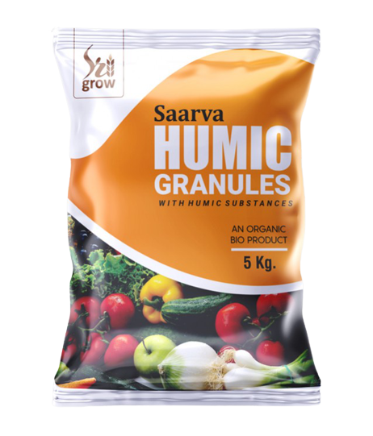
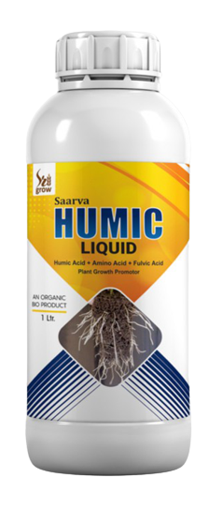
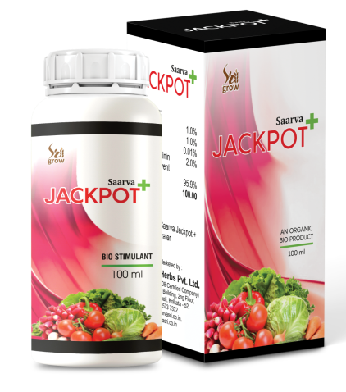
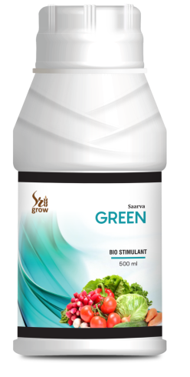
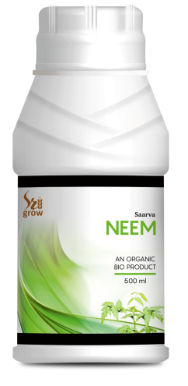
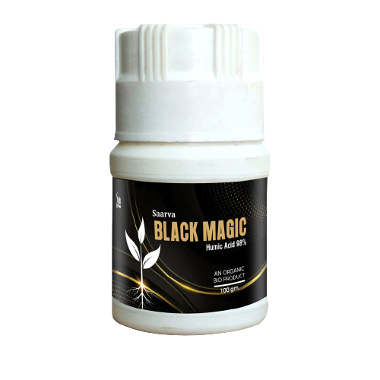
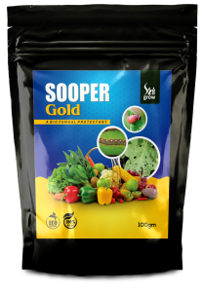
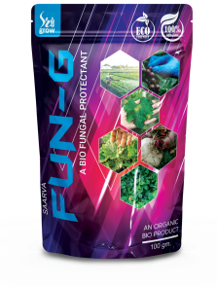
BENEFITS
Stimulate beneficial microbial activity
Improve soil structure
Promotes humus production
Increase root vitality
Improve water holding capacity
Better seed germination
Eco friendly
Healthier plants, healthier people
Bio-diversity
Social equality
Control of air pollution
Control of water pollution
Prevention of soil erosion
Advocate for better treatment of animals

Slide 4
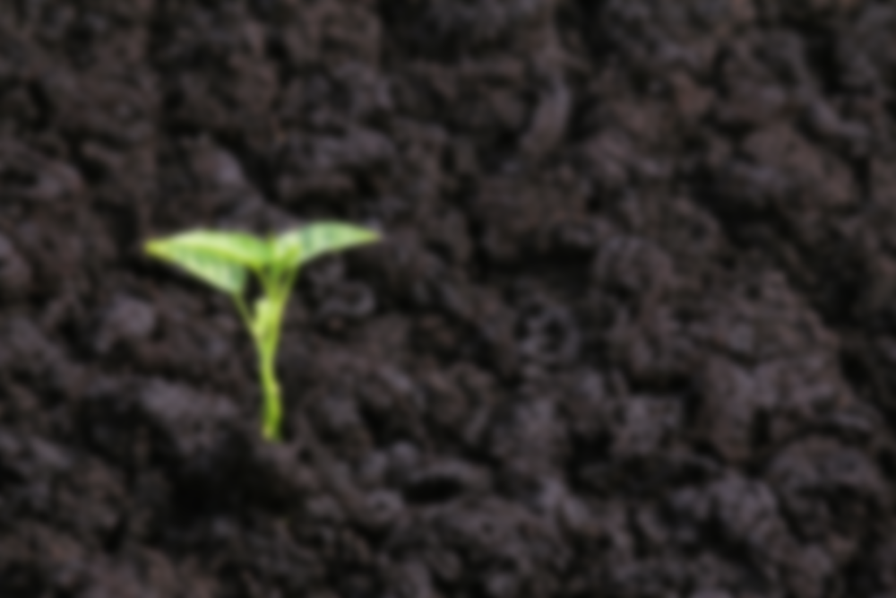

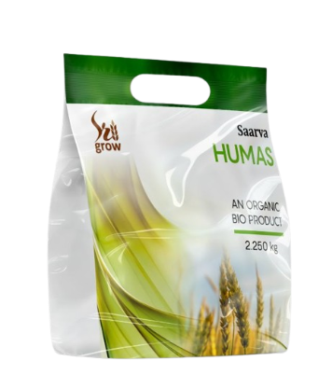
Saarva humas is a ready to use type of Granular product containing major amino acids and Humic acid from natural source and other benefitial ingredient which boost plant growth and vigour. saarva humas acts as an organic catalyst on plant membrane in addition to growth promoting activities. Saarva humas enhances resistance to stress, promote xylem differentiation, improves quality and size of fruit, increase yield etc.
Saarva
HUMAS
BENEFITS
Vigorous root development
improves humus in soil
improves carbon ratio in the soil
helps absorb N P K & micronutrients
improves soil PH condition
Higher yields
improves the quality of produce.
DIRECTION OF USE
2.25 kg. pare acre to be applied directly in soil along with organic or chemical fertilizer.

Slide 5

Saarva
Saarva Humic Granules are concentrated fractions of organic matter that is ideal for crop field and vegetable garden. It acts as natural soil conditioner which includes a high concentration of trace minerals and organic acids.
HUMIC
GRANULES
BENEFITS
Increases soil fertility
Increases crop production
Encourages root development
Stimulates the growth of microorganisms
Acts as soil conditioner
Prevent fungus and other bacteria prone disease
DIRECTION OF USE
It should be used 5-8 kg per acre in case of field crops and 100-150 gm per tree in case of perennial or vines 25 days after planting/sowing or 30 days before flowering.

Slide 6

Saarva
Saarva Humic Liquid is 100% Organic Liquid Fertilizer. It is an ideal additive to boost bio-activity and improve the performance of compost, soil structure and plant nutrients intake. Saarva Humic Liquid is designed with the best proportion of Humic Acids, Amino Acids and Fulvic Acids.
HUMIC
LIQUID
BENEFITS
Increases health, quality and yield of crops, trees, turf (grass/lawn) and garden plants
Enhances growth of soil microorganisms, this helps to improve the soil structure, balance PH levels, and protect crops against harmful toxins and metals
Increases the amount of organic matter in the soil
Stimulates root development, enhances phosphate utilization of plants
Helps soil to retain water
Can be used to accelerate decomposition of compost
Improves the taste of fruits and vegetables, increases yields and improves quality
DIRECTION OF USE
300-600 ml per acre for foliar spray and 1000 ml per acre for drenching or drip irrigation.
For seed dressing, mix 5 ml with 1 kg of seed thoroughly and sow.
During growth flowering and fruit formation stages use 2 ml per 1 ltr of water as a spray.

Slide 7

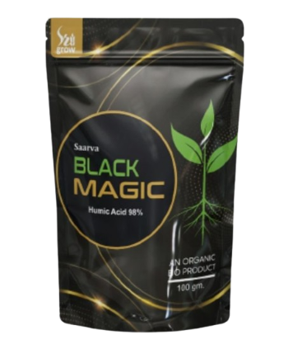
Saarva
BLACK MAGIC
INGREDIENTS
Humic Acid-98% and other trace elements.
BENEFITS
Used for plant growth & Development
Enhances root growth
Develops lateral root system
Maintains pH balance
Develops fruit quality
Develops the count of bacteria in soil
DIRECTION OF USE
10 to 15 gm for 15 liter water or mixed with cow dung, vermi-compost and fertilizer 250gm per acre.

Slide 8

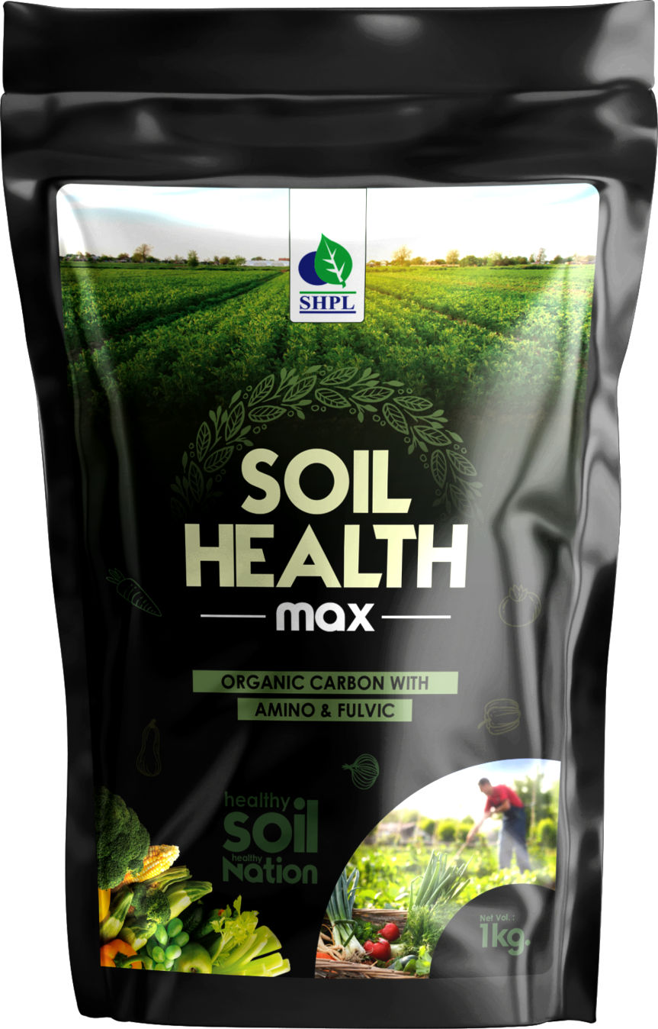
SOIL HEALTH MAX
SOIL HEALTH MAX determines soil quality, fertility, agricultural profitability, and atmospheric carbon dioxide (CO2) fixation. Contains plant hormone which regulates virtually every aspect of plant growth and development. Soil health max causes early germination of seeds by about 1 to 3 days and increases the germination rate of seeds by 10 to 30 percent.
BENEFITS
Provides nutrients present in the soil immediately.
It helps in the overall growth of plants and prevents untimely fall of the fruit.
Helps in the growth of flowers and fruits.
Increases the disease resistance capacity of the crop.
Increases the weight, shine, quality and size of the fruit.
Increases the process of photosynthesis.
Grows white roots very quickly.
Improves the soil's ability to absorb and hold water.
DIRECTION OF USE
1 Kg per Acre can be mixed with soil during land preparation(tillage) or for soil application apply near the root zone with any fertilizer.
For plantation crops apply each tree with20gms can be mixed with any soil application fertilizers.

Slide 9

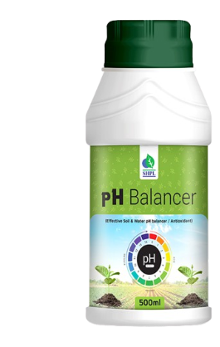
pH BALANCER
INGREDIENTS
Humic Acid-98% and other trace elements.
BENEFITS
Used for plant growth & Development
Enhances root growth
Develops lateral root system
Maintains pH balance
Develops fruit quality
Develops the count of bacteria in soil
DIRECTION OF USE
10 to 15 gm for 15 liter water or mixed with cow dung, vermi-compost and fertilizer 250gm per acre.

Slide 10


Saarva
+
JACKPOT
INGREDIENTS
Ginseng, Fulvic Acid, Natural Bacinolide, Natural Cytokinin, Amino Acids, Various Natural Enzymes
BENEFITS
Effective for the production of more crops
Helps grow root & root hair
Prevents premature fall of the flower
Increases the size of the fruit
Prevents premature fall of the fruit
Increases the quality of the fruit
Accelerates the growth of the tree
Prevents premature death of the tree
Stops yellowing of the leaves
DIRECTION OF USE
5-7 ml. Mix every 15 liters of water

Slide 11


Saarva
GREEN
INGREDIENTS
Humic Acid 12%, amino acid 5%, Fulvic Acid 5%, seaweed Extract 5%,
BENEFITS
Accelerating germination
Enhancing seeding
Vigour and root growth
Improving uptakes and translocation if micro and macro nutrients
Inducing early maturity, helping plants draught, resulting in higher yield and better quality of crop produces
Increase metabolism and nutrient levels
Increasing the formation of pollen and fruits in plants
DIRECTION OF USE
Seed Treatment: 5.0 to 10 ml./kg. seed in sufficient quantity of water
Seeding/Root dip: 2.0ml. per litter of water
Foliar spray: 2 to 3 ml. per litter of water at actively growing and reproductive stages

Slide 12

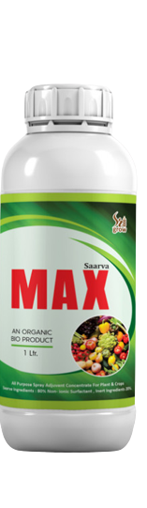
Saarva
MAX
BENEFITS
Increases yield by 25-30%
It is 100% water soluble
Saves 25-30% chemical fertilizer like Urea and D.A.P.
It is a plant growth promoter which promotes and enhances the fertility of the soil to produce distinguished crops
Induces flowering and fruit setting
Increases enzymic activity and encourage balanced hormonal synthesis
Better root development ensures higher nutrients and water absorption
Can provide more uniform spray deposit on plantsis
Improves coverage of insecticide, herbicide, fungicide and foliar fertilizer sprays
Increasing water penetration
Helps improve performance of post-emergent herbicides, insecticides, and fungicides thorough wetting action
As an Activator-Wetter-Spreader, it activates the spray fluid to moisten the plant surface & allows uniform spreading of spray deposit
DIRECTION OF USE
Mix 5 ml. of Max per 15 ltr. Of pesticides or any kind of solution

Slide 13

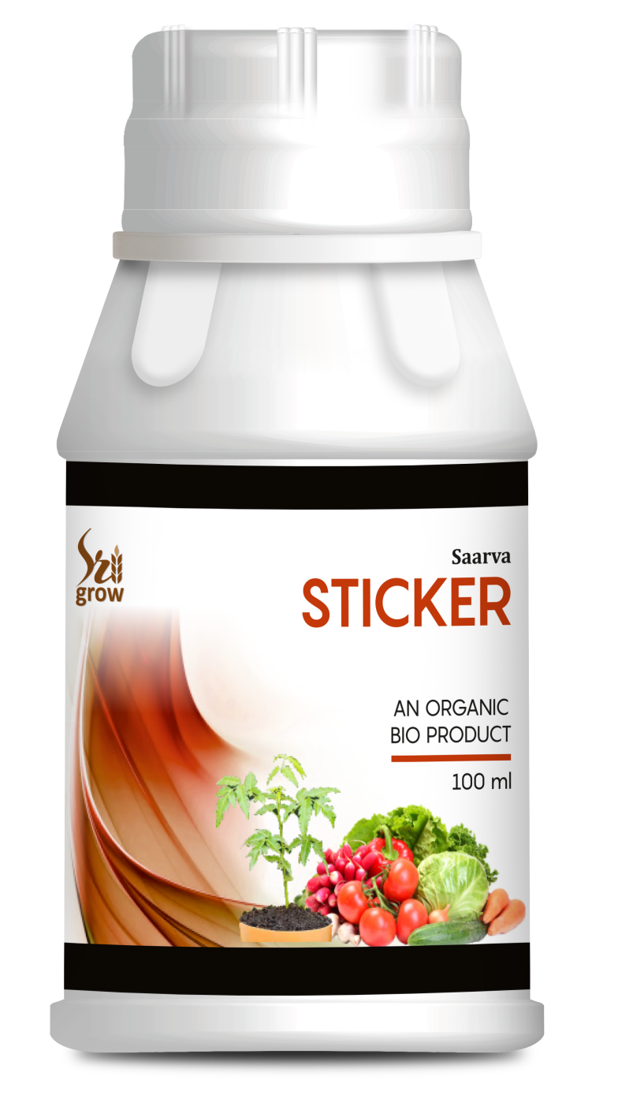
Saarva
STICKER
Saarva Sticker is a non-ionic, super spreading spray adjuvant based on a Trisiloxane Alkoxylate. It is most effective as a tank side adjuvant when spray mixtures are with in the PH range of 5-8 and are used 24 hours within preparation of the spray solution.
BENEFITS
Improves spray coverage & promotes spray volume reduction
Promotes rapid uptake of agrochemicals into plants via stomata.
DIRECTION OF USE
5-7 ml per 15 litter of any agricultural solutions

Slide 14
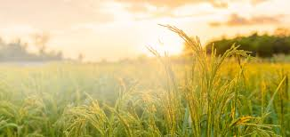

Saarva
NEEM
Saarva Neem is made from the fruit kernels of the neem tree (Azadirachta indica). Neem seeds hold the highest concentration of the insecticidal compound. The effective compound is azadirachin, which repels the insect pest. It breaks down quickly and leaves no lasting residue.
BENEFITS
Prevents insects by natural means
Destroys all parasites on the tree or on the ground
Protects the tree from all kind of pests and insects
Capable of preventing about 200 types of pests
Can also kill fungal diseases
DIRECTION OF USE
25 to 30m for 15 liter or mixed with fertilizer 1L per acre. Use again after 10 day.

Slide 15


Saarva
FUN-G
BENEFITS
FUN-G inhibits most of the fungal infections of the plants.
It prevents Leaf Spot, Blast disease and Rust disease in all vegetable plants.
It protects the plants for lengthy period of time.
It is a bio-fungicide which destroys or prevent fungal growth and their spores.
It kills fungal cell membranes and interrupt energy production within fungal cells.
DIRECTION OF USE
1 gm mixed with 1 litter of water and spray.

Slide 16
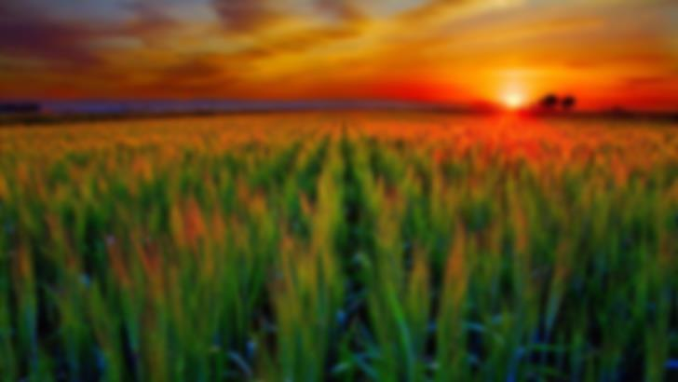
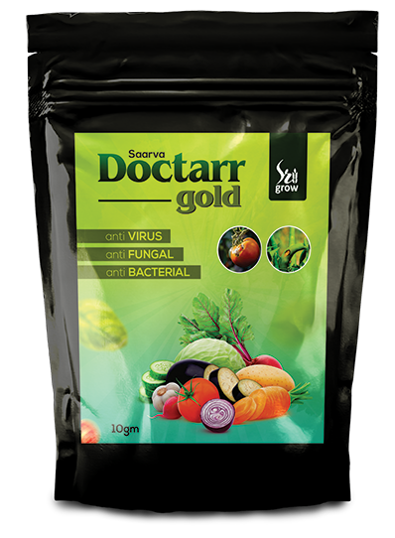
Doctarr
Saarva
gold
Saarva Doctarr Gold is the result of many years of hard labour and research. It is a unique formulation of Saarvasri. It is the combination of Antivirus, Antifungal, Antibacterial, Microbicide & Germicide. It is 100% organic, residue free and harm free to crops.
BENEFITS
Inhibits most fungal infection
Effective against soil borne fungal and bacterial infection
Resulting sudden death of target bacteria and Virus spores
Effective against disastrous strains
Stimulates cytokinin synthesis resulting in excellent plant growth after viral and bacterial attack.
DIRECTION OF USE
10 gm in 15 ltr of water. For better result repeat spray within a week.

Slide 17

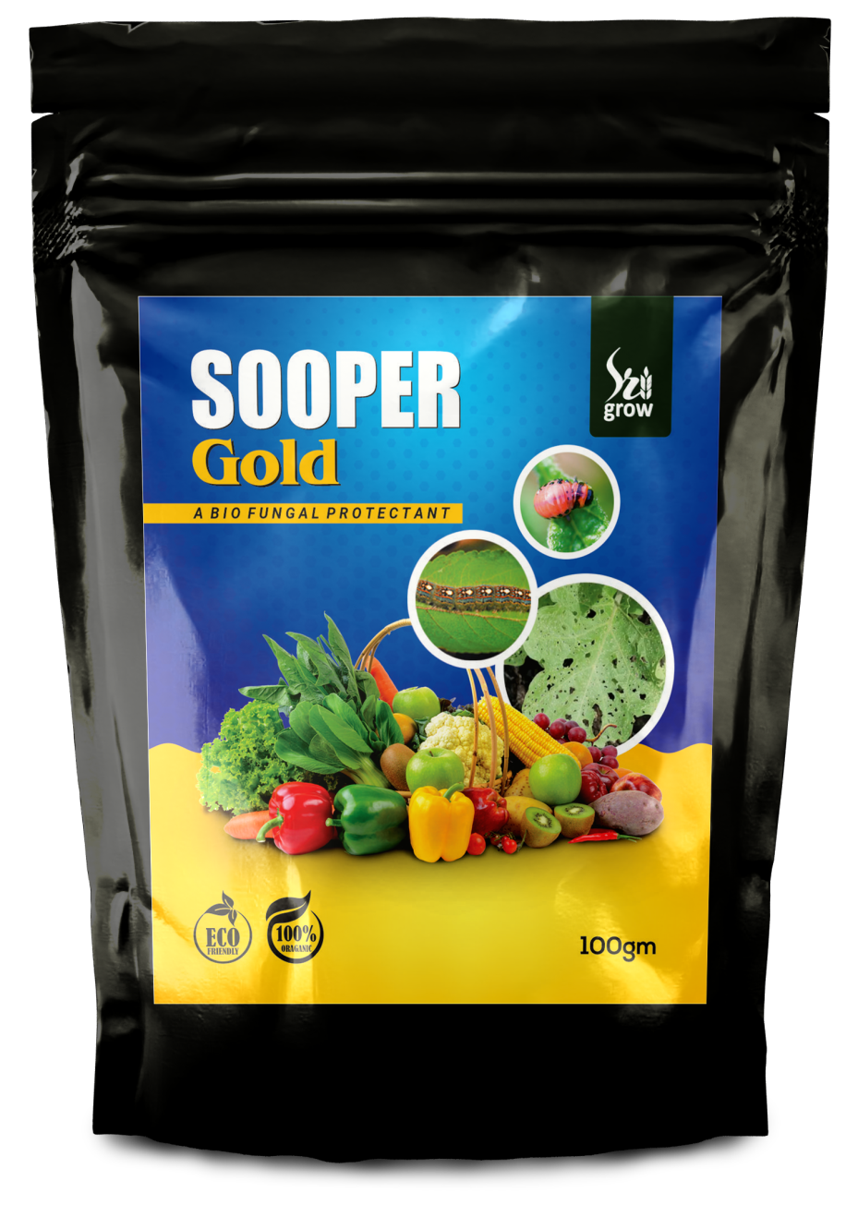
SOOPER
Gold
Sooper Gold is 100% natural, organic & ecofriendly product. It is effective on almost all target pest organically. It is more effective when use as preventive as well as curative. It is absolutely harm free for crops and crop friendly insects. As well it protects plants from deformation, defoliation, stunting & dwarfing. Effective against all mites white fly, caterpillar, thrips, aphid, jassid, leaf miner etc.
DIRECTION OF USE
1-2 gm per 1 ltr water.

Slide 18


