Slide 1
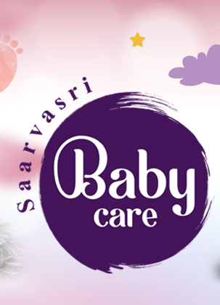


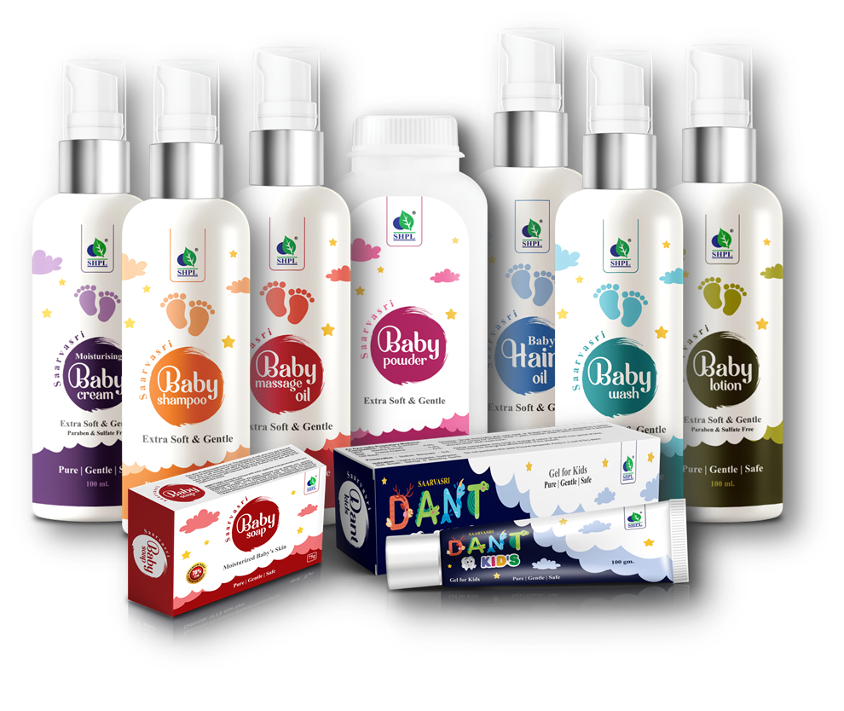
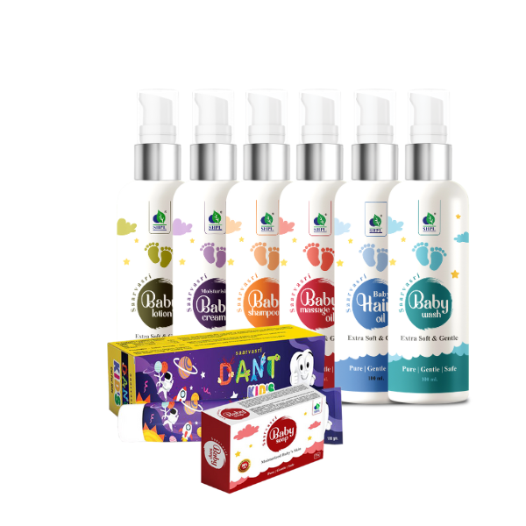

Slide 2

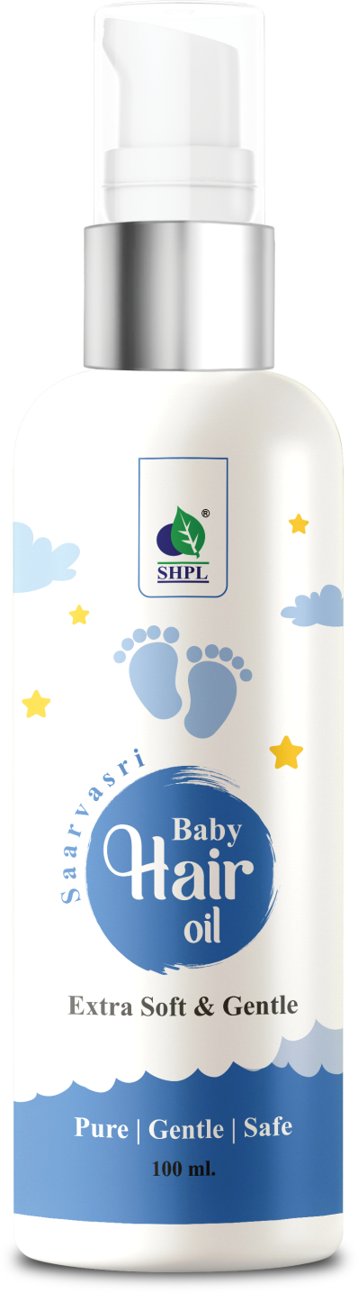
BABY
Hair Oil
Saarvasri Baby Hair Oil helps nourish, protect and strengthen your baby's hair, keeping them soft and silky. It is a toxin-free combination of some powerful herbal oils and natural herbs like Black Til Oil, Coconut Oil, Anant Mul, Bhringraj, Amla, Nili, Indrayan, Mehendi, Chameli, Brahmi, Sankhpushpi, Bahed, Malkangi, Bavchi, Neem, Khus and Karanj to protect delicate hair from damage and dryness.
HOW TO USE
Apply oil to the baby’s scalp and gently massage with your fingertips in a circular motion.

Slide 3
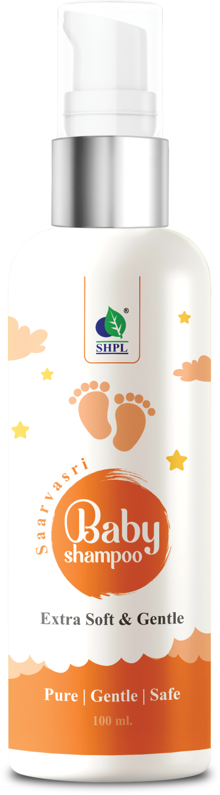
BABY
Shampoo
Saarvasri Baby Shampoo is a gentle and caring formula designed for your baby's delicate hair & scalp. It contains natural ingredients. Overall, this baby shampoo is formulated to cleanse and care for your baby's hair while being gentle on the scalp. It clears and conditions the oily scalp, restores baby’s natural scalp moisture, aids regeneration of hair follicles increases blood circulation to your child’s scalp, nourishes dry hair and scalp with a warm and gentle touch of moisture.
HOW TO USE
Apply Baby Shampoo to wet hair, lather gently and rinse thoroughly for a gentle and refreshing cleanse. Avoid contact with eyes.

Slide 4
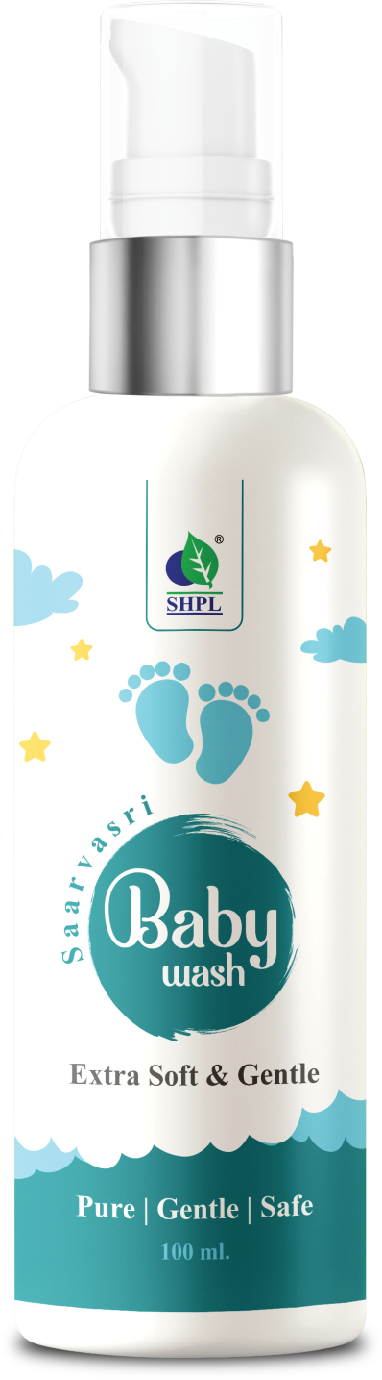
BABY
Wash
Saarvasri Baby Wash is a gentle and nurturing formula designed to cleanse and care for your baby's delicate skin. This formulation helps to hydrate your baby's skin while being gentle and nurturing. It purifies, moisturizes and protects baby’s skin, reduces skin dryness and treats rashes, maintains skin’s moisture, texture and softens the baby’s skin. The soothing benefits of Aloevera provides intense hydration to baby’s skin.
HOW TO USE
Apply Baby Wash to wet skin, lather gently and rinse thoroughly for a gentle and refreshing cleanse.

Slide 5
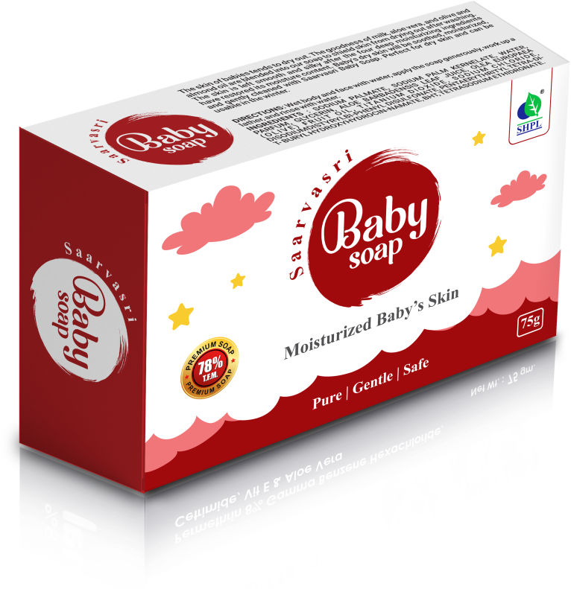
BABY
Soap
The skin of babies tends to dry out. The goodness of milk, aloe vera, and olive and almond oil are blended into our soap to shield skin from drying out after washing. The skin is left smooth and silky after the four deep moisturizing ingredients have restored its moisture content. Baby's dry skin will be soothed, moisturized, and gently cleaned with Saarvasri Baby Soap. Perfect for dry skin and can be usable in the winter.
HOW TO USE
Wet body and face with water, apply the soap generously, work up a lather, and rinse with water.

Slide 6
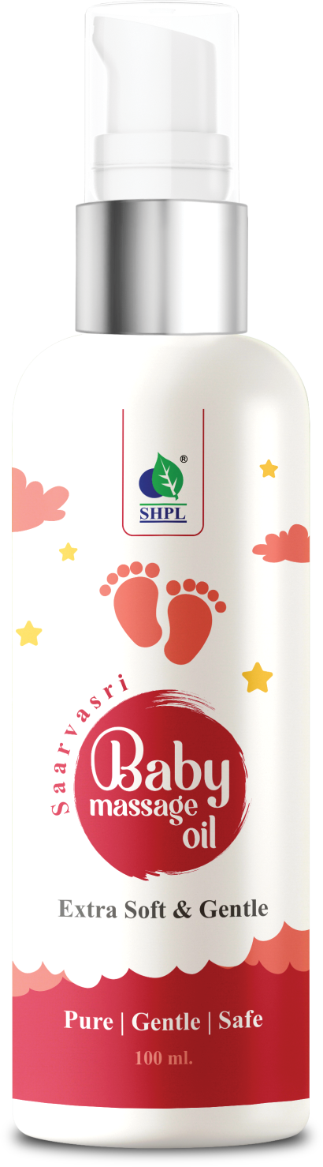
BABY
Massage Oil
It is a well-known fact that massaging a baby daily is important as it helps strengthen their bones and provide nourishment. Saarvasri Baby Body Massage Oil is infused with herbs-based oil that helps nourish the baby's skin and promote overall growth and development. It deeply moisturizes and has anti-inflammatory properties to heal, soothe and helping them to have a good sleep. Use daily to protect your baby’s skin from dryness and retain moisture.
HOW TO USE
Pour oil into your hand. Rub both hands together to warm oil. Gently massage all over your baby’s body.

Slide 7
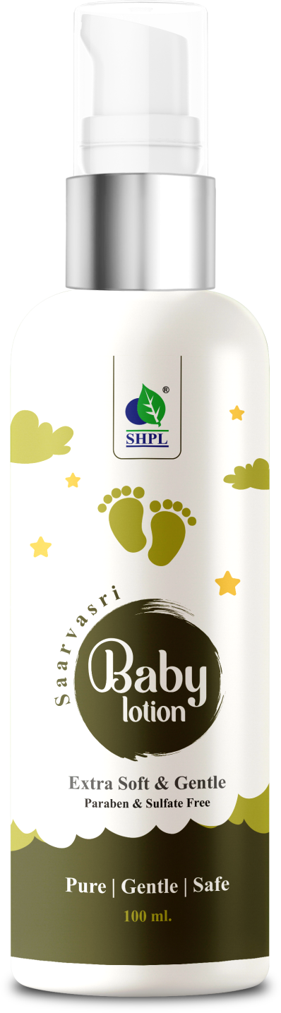
BABY
Lotion
SHPL Baby Lotion is a nourishing and hydrating formula designed to keep your baby's skin soft and moisturized. It is rich in powerful ingredients like Almond Seed Oil, Avocado Oil, Olive Oil, Wheat Germ Oil & Jojoba Oil. It re-hydrates dried skin, replenishes extra dry or rough spots on the skin, feel soft and smell good & keeps moisture all day long.
HOW TO USE
Apply a small amount of baby lotion to baby's skin, gently massage and leave it to absorb for soft, hydrated skin.

Slide 8
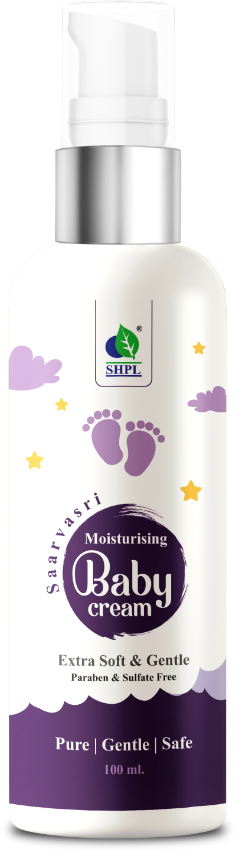
MOISTURISING
Baby Cream
Saarvasri Moisturising Baby Cream significantly improves the baby’s skin texture. This is mainly due to the presence of Aloevera, Almond Oil and Olive Oil in it. Moreover, it is packed with Vitamin E that helps in soothing the baby’s skin. It helps to reduce swelling and redness on the skin. It moisturizes the skin and keeps it soft, smooth, and gentle.
HOW TO USE
Apply this cream to the baby’s body and gently massage with your palms in a circular motion.

Slide 9
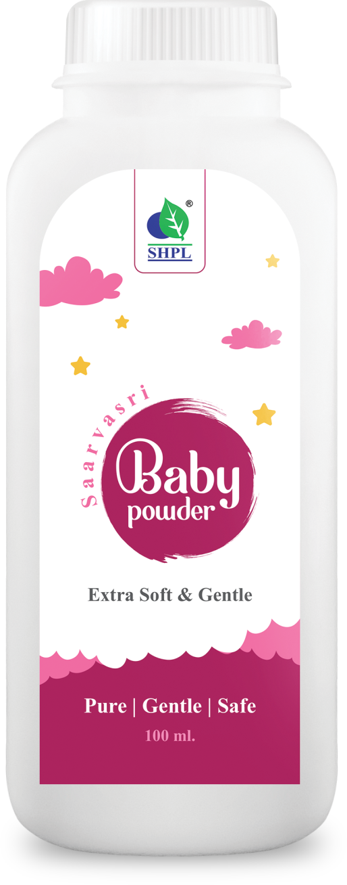
BABY
Powder
Saarvasri Baby Hair Oil helps nourish, protect and strengthen your baby's hair, keeping them soft and silky. It is a toxin-free combination of some powerful herbal oils and natural herbs like Black Til Oil, Coconut Oil, Anant Mul, Bhringraj, Amla, Nili, Indrayan, Mehendi, Chameli, Brahmi, Sankhpushpi, Bahed, Malkangi, Bavchi, Neem, Khus and Karanj to protect delicate hair from damage and dryness.
HOW TO USE
Apply oil to the baby’s scalp and gently massage with your fingertips in a circular motion.

Slide 10

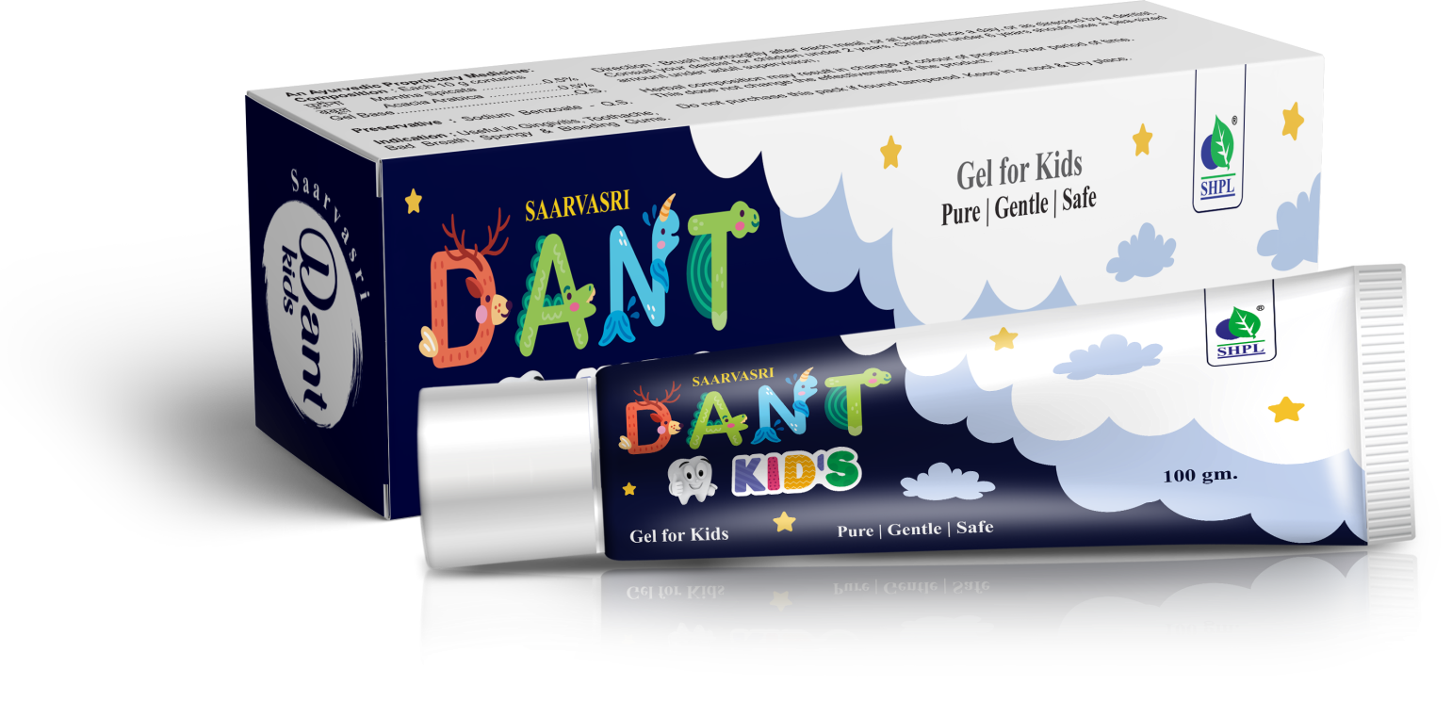
Dant Kids
TOOTHPASTE
Introducing Saarvasri Dantkid’s Toothpaste which is specially designed for kids. It helps in reducing dental plaque and cavity-causing bacteria in your child’s mouth. Babool in Dantkid’s toothpaste prevents cavities and strengthens enamel. Brushing with it every morning and night can ensure strong & healthy teeth for your child.
HOW TO USE
Use a small amount of Saarvasri Dantkid’s toothpaste, about the size of a grain of rice, on a soft-bristled toothbrush. When your child is about 3 years old, you can use a pea-sized amount of toothpaste.

Slide 11
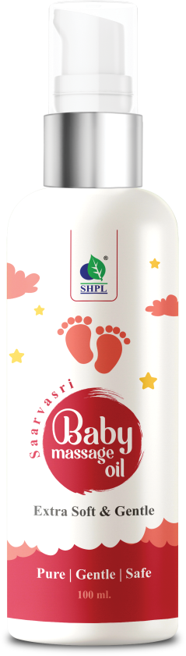


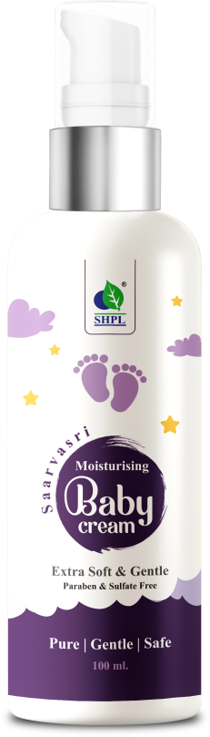
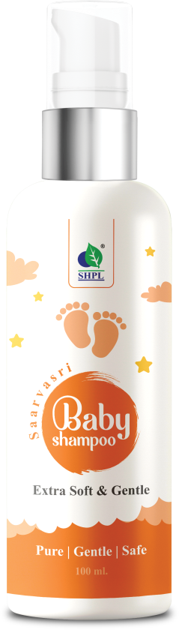
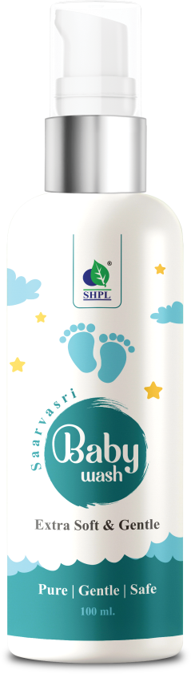
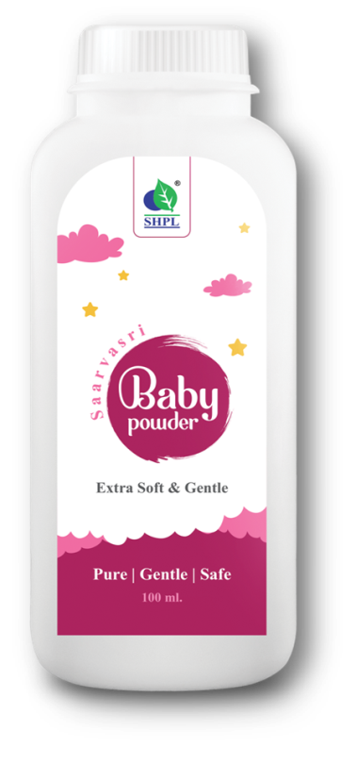
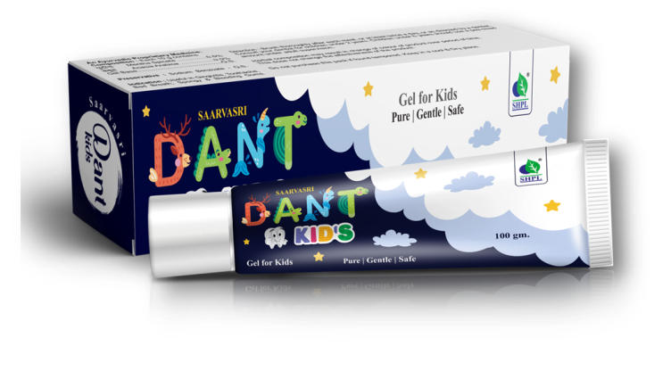
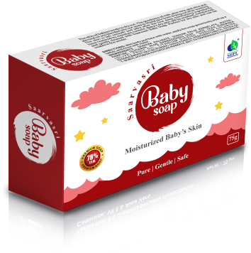
Disclaimer
SHPL Baby Care products are not intended for diagnose or treat any health problem.
Take an Expert’s advice before use.
For external use only.
Store in cool & dry place.

Slide 12


