Slide 1


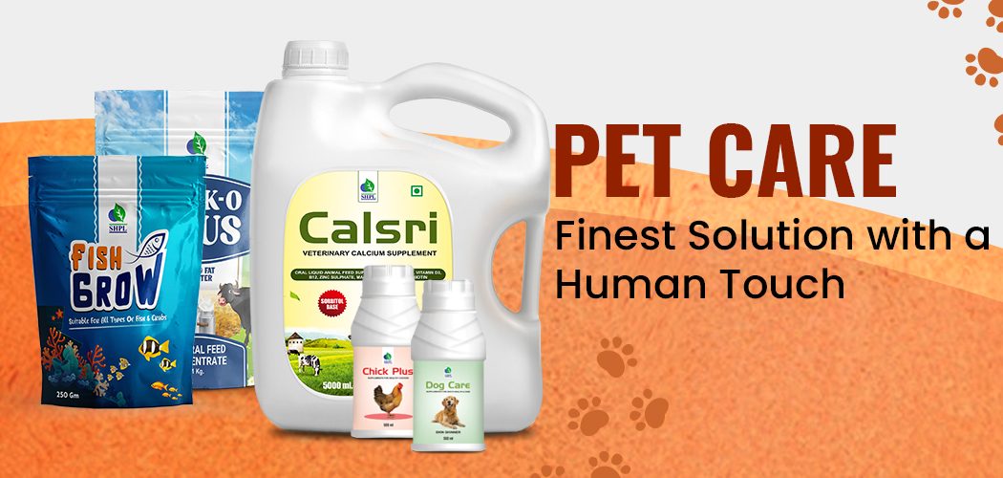
ANIMAL CARE

Slide 2
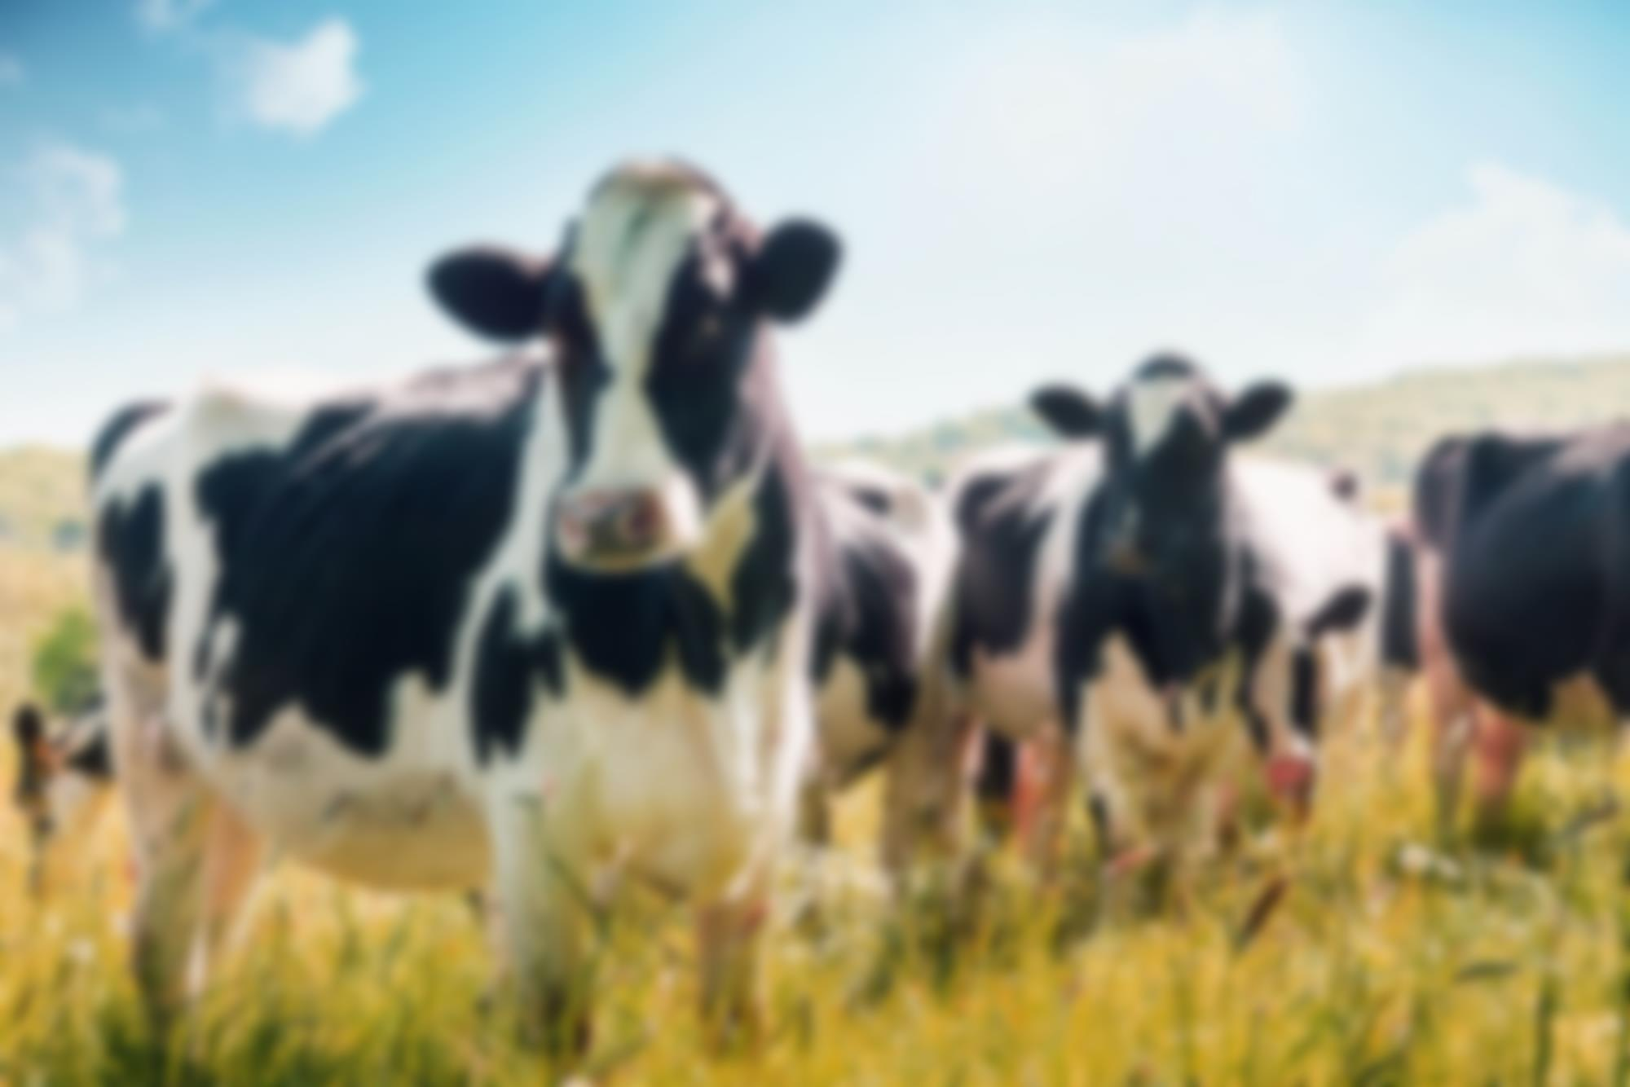
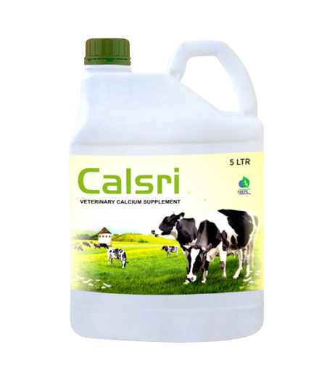
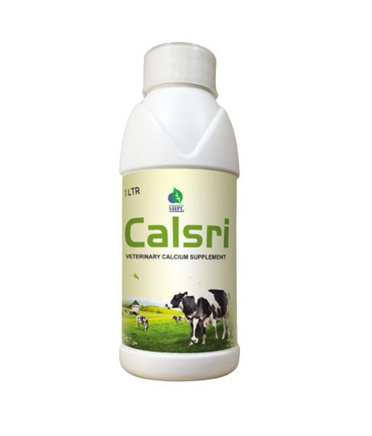
Calsri
VETERINARY CALCIUM SUPPLEMENT
INGREDIENTS
Calcium , phosphorus, vitamin D3 & B12, Satavari and jivanti.
BENEFITS
Improving milk yield in cattle Buffalo.
Formulation of strong bones in growing animals.
Improving calcium deficiency.
It increases milk output & fat percentage.
It help for the formation of strong bones in growing animals.
DOSAGE
Cattle & Buffalo: 100 ml daily and for Calves: 20 ml twice daily.

Slide 3
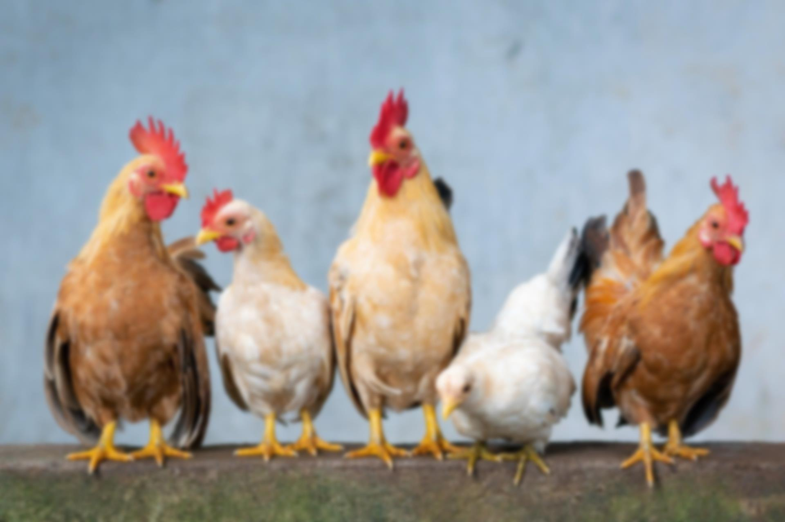
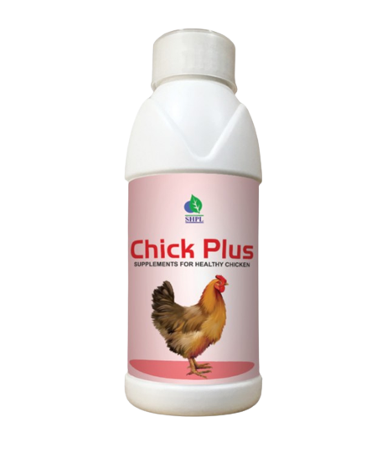
CHICK PLUS
SUPPLEMENTS FOR HEALTHY CHICKEN
INGREDIENTS
Arginin, Cystine, Glycine, Histadine, Isolucine, Leucine, Lysine, Methionine, Phynyle alanine, Serine, Thyrosine, Threonine, Tryptohan, Valine, L-Iysine hcl, Sodium, Magnesium, Chloride, Manganese, Zinc, Iron, Copper, Iodine, Cobalt, Papain, Yeast extract, Sucrose.
BENEFITS
DOSAGE
Boost the quality of production
Improve laying duration
Keep them healthy and active
Parasite resistance
Bring stability of gut microflora
Prevent bacterial diseases
Builds bone health
Prevent them from seasonal illness
Improve metabolism
Ensure the quality of eggs & meat
Maintains healthy liver & kidney functions
Decrease mortality rate
15 ml per 100 Chicken daily

Slide 4
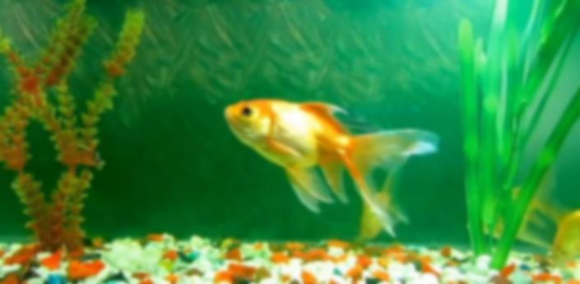
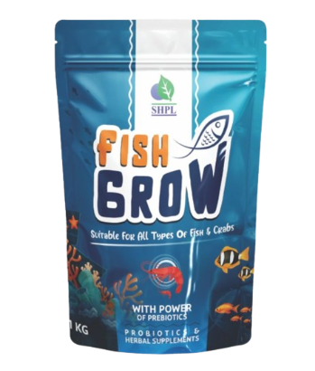
FISHGROW
SUPPLEMENTS FOR FISH
INGREDIENTS
Vitamin: D3, A, E, K, B1, B2, B3, B5, B6, B12, B7, B9
Minerals: Manganese, Zinc, Iron, Copper, Iodine, Selenium, Cobalt
BENEFITS
Enhances the liver performance and reduces toxicity of liver
Prevents and treats the diseases of shrimp and fish like as hepatitis diseases, rotten liver diseases, white liver disease, liver-kidney disease, swelling liver disease etc
Promotes low feed conversion ratio (FCR) and weight gain
Makes crude protein and Amino acid digestible
Improves absorption of calcium phosphorus
Corrects disorders of liver and spleen
DOSAGE
500g fish grow mix with 500kg fish food.

Slide 5

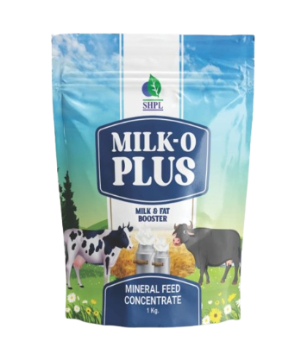
MILK-O PLUS
MINERAL FEED CONCENTRATE
Loaded with multivitamin, multi-minerals, digestive enzymes, prebiotics, probiotics & natural herbs, Milk-O Plus is best for all lactating and non-lactating animal. It is a complete nutritional supplement for animals. 100% natural & safe. It helps to boost milk & fat with other benefits.
INGREDIENTS: Calcium, Phosphorus, Iron, Manganese, Magnesium, Copper, Zinc, Cobalt, Iodine, Selenium, Chromium, Sodium, Potassium, Vitamin A, Vitamin D, Vitamin E, Vitamin B2, Vitamin K, Vitamin B12, Vitamin B7, Protein, Fat, Omega 3, Omega 6, Omega 9, Prebiotics, Probiotics, Digestive Enzymes, Shatavari, Methi, Mulethi, Jivanti, Ashwadandha, Moringa, Giloy & Cumin.
DOSAGE:
For Cow, Buffalo & Large Animals: 30gm per day with their feed.
For Goat, Sheep & Lamb: 15gm-20gm per day with their feed.
For other non-lactating animals: 15gm-20gm per day with their feed.
BENEFITS:
Increases milk yield and fat content
Improves digestion
Decreases metabolic disorders
Controls various diseases
Boosts reproductive performance
Boosts immunity power

Slide 6


