Slide 1




Slide 2
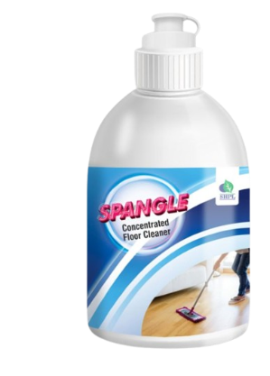

SPANGLE CONCENTRATED FLOOR CLEANER
DESCRIPTION
SPANGLE CONCENTRATE FLOOR CLEANER is much more beneficial than a normal cleaner. SPANGLE CONCENTRATE FLOOR CLEANER advanced formula keeps marble and granite floor sparking clean & maintain hygiene. It gives you the cleanliness that is ideal for floor, toilet, basin, etc. It is safe on hands. It is specially formulated to clean grease and stubborn stains. It is environment-friendly and gives a pleasant lingering pine fragrance.
HOW TO USE
Sweep the floor to remove dust. Add 2 caps to a small bucket of water (6 lt). Squeeze after every mop as usual, leave to dry.

Slide 3
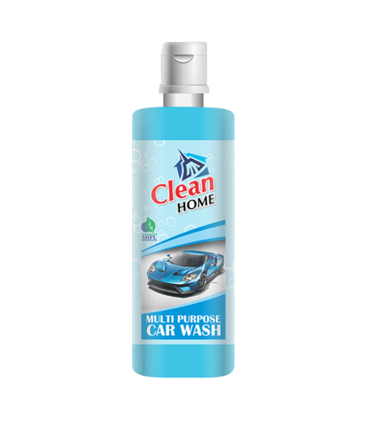
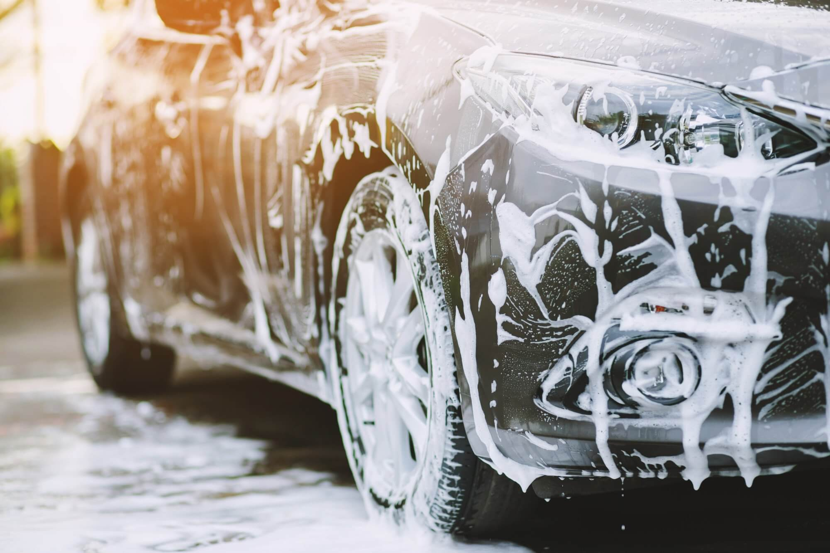
CAR WASH
MULTIPURPOSE
DESCRIPTION
High quality Saarvasri Herbs Car Wash removes dirt quickly and thoroughly. It has a soft feel to the water which can give the best results when washing cars with extra foam based formulas. The Super Silk formula is enriched with a gloss enhancer and wax to provide a Super Silk finish to all painted and glass surfaces.
BENEFIT
It helps remove road dirt, traffic debris and other pollutants efficiently
HOW TO USE
Mix a few drops of Car Wash with water as per your requirement and apply.

Slide 4
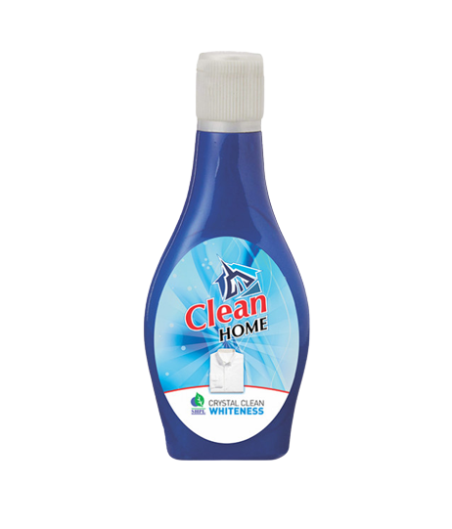
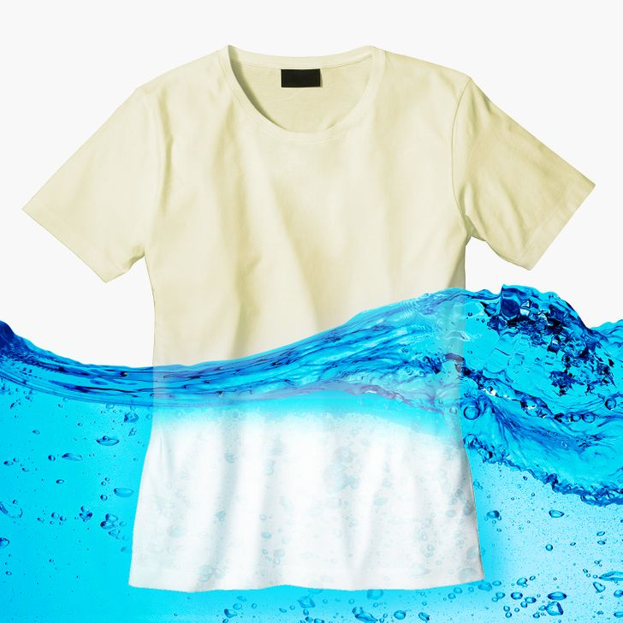
WHITENESS
CRYSTAL CLEAN
DESCRIPTION
Sarvasree Herbs Crystal Clean Whiteness brightens fibers and gives your clothes the whiteness they deserve. It contains ultra-bright molecules, which help it dissolve faster, penetrate deeper and leave your clothes sparkling white.
BENEFITS
The blue tint on white fabrics absorbs the yellow part of the spectrum, thereby making the yellowish tint invisible.
HOW TO USE
Mix 4 drops of Crystal Clean Whiteness with a bucket of water and use on your washed clothes.

Slide 5
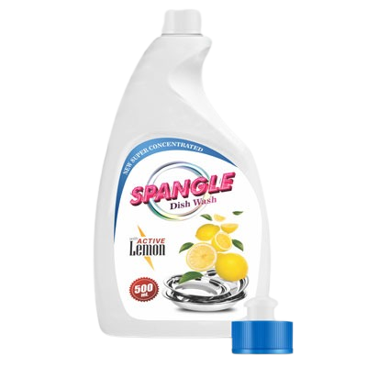
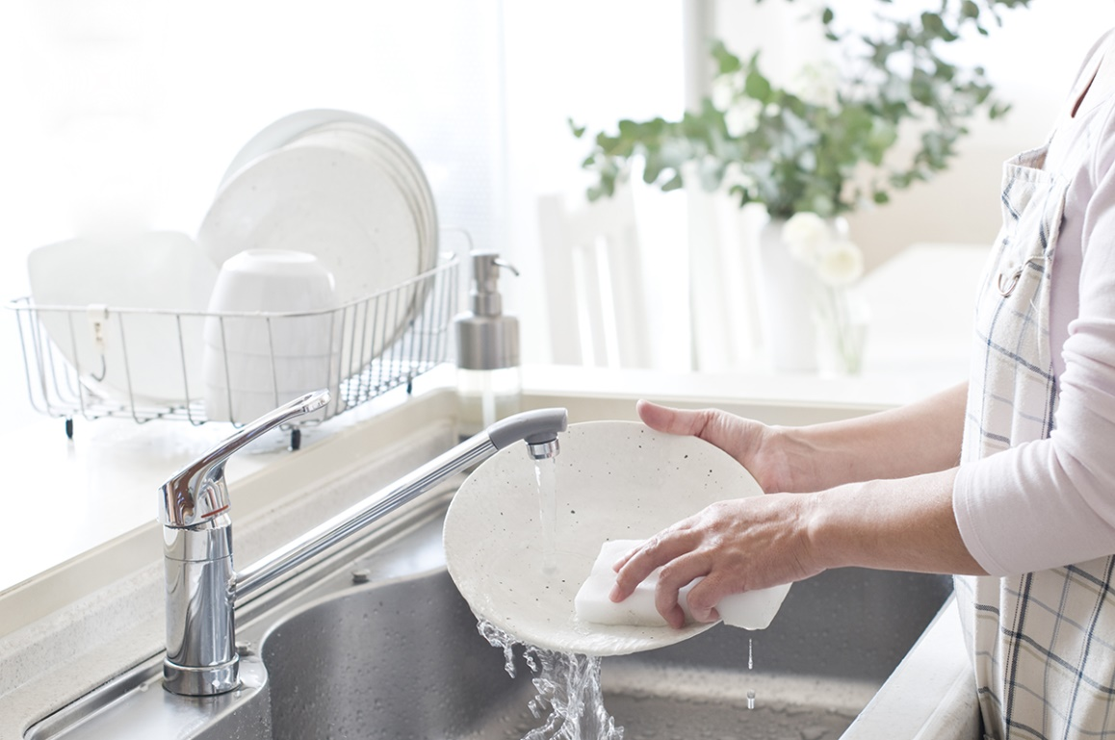
SPANGLE
DISH WASH
DESCRIPTION
Spangle Liquid Dish Wash is generally mild, it is frequently a better choice as a household cleaner than other harsh chemicals. That is why it can be a great alternative to other harsh cleaners and can be used for washing your dishes.
BENEFITS
Apply some dishwashing liquid directly to a wet sponge. It cleans the toughest grease and burnt stains and removes residual food odors.
HOW TO USE
Mix the dish wash with water as per your requirement and apply it to the areas you need.

Slide 6
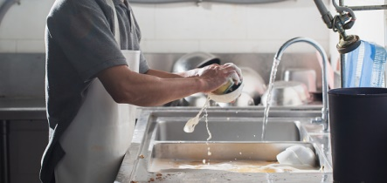
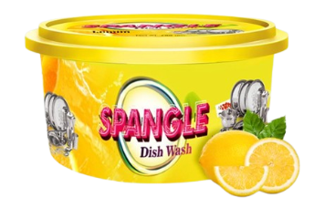
SPANGLE
DISH WASH TUB
DESCRIPTION & BENEFIT
Lime & Orange Dish Wash Tub contains the power of lemon to clean grease and burn marks from dishes and help remove odors from dishes.
HOW TO USE
Use a scrubber to get shiny and stain-free dishes. Use regularly.

Slide 7
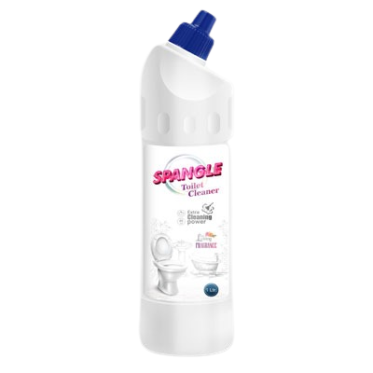
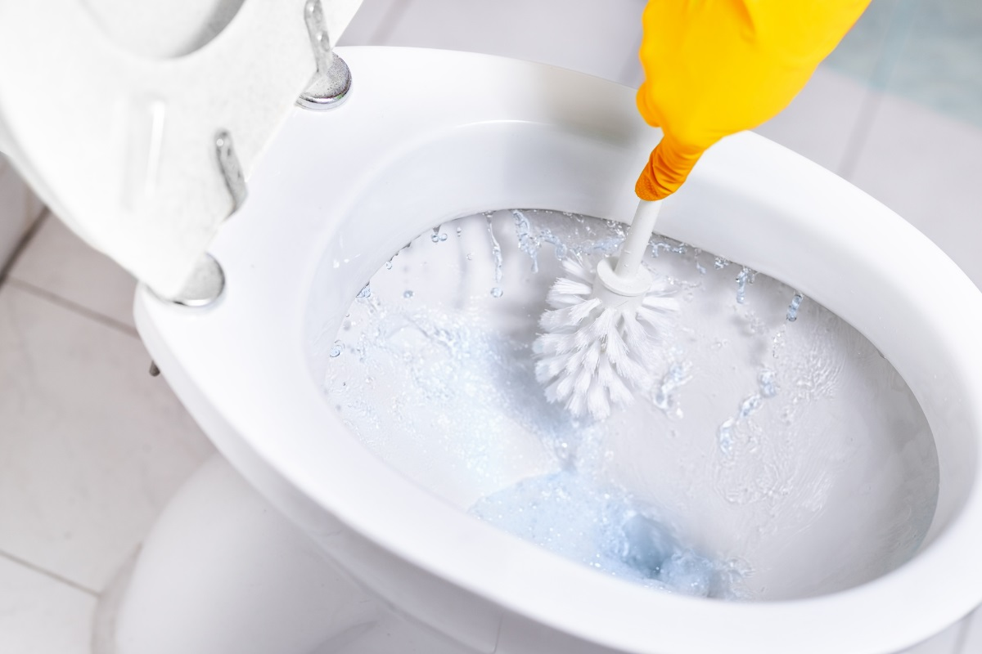
SPANGLE
TOILET CLEANER
DESCRIPTION & BENEFIT
Toilet cleaner is a powerful formula for removing stains from toilets and washrooms. Toilet cleaner is very effective against scaling and heavy stains. Toilet cleaners can be safely used on urinals, commodes, bathtubs, sinks and basins.
HOW TO USE
Squeeze it around the commode and leave it on for 10 to 15 minutes for glowing results. Scrub and flush the inside of the commode with the brush.

Slide 8
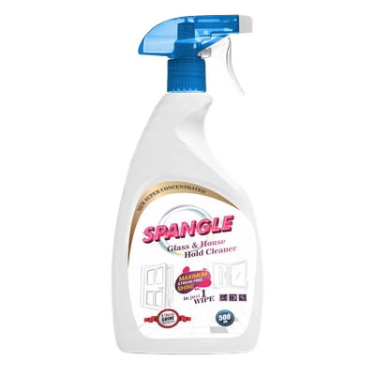
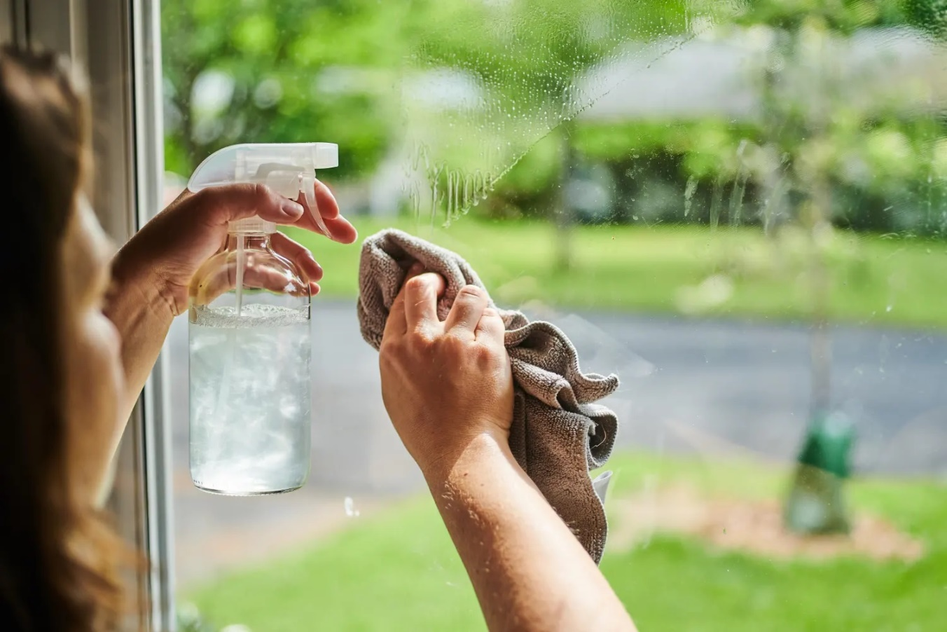
SPANGLE
GLASS & HOUSE HOLD CLEANER
DESCRIPTION & BENEFIT
Glass cleaner easily cleans dust, smoke and grease on all types of glass surfaces.
HOW TO USE
Mix the Glass Cleaner with water as per your requirement and apply it on the required area.

Slide 9
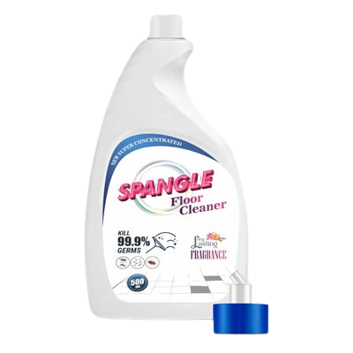
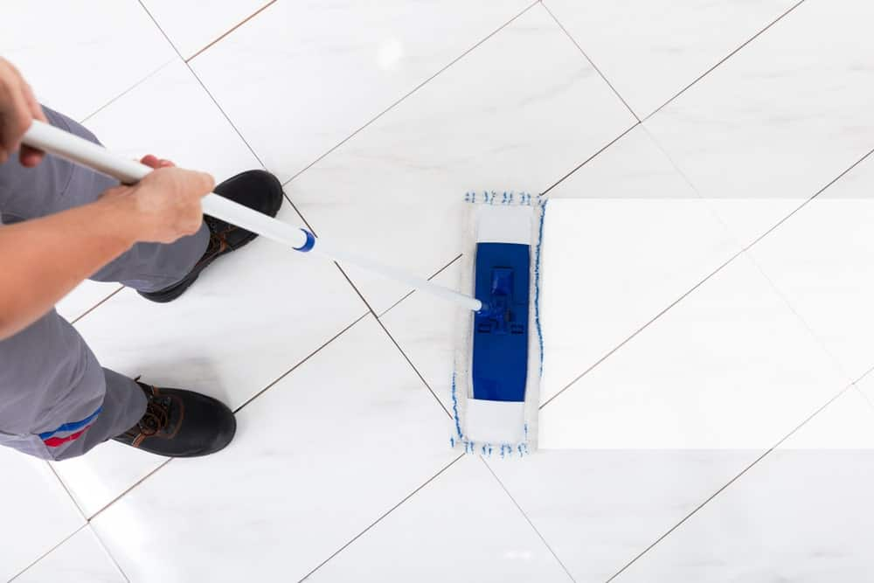
SPANGLE
FLOOR CLEANER
DESCRIPTION & BENEFIT
Floor Cleaner is a general purpose concentrated cleaner cum sanitizer. Ideal for quick cleaning on any hard surface such as floors. Daily mopping is crucial for keeping surface dirt away; deep cleaning will help to preserve floors from damaging dirt and water.
HOW TO USE
Mix the floor cleaner with water as per your requirement and apply it on the required area.

Slide 10
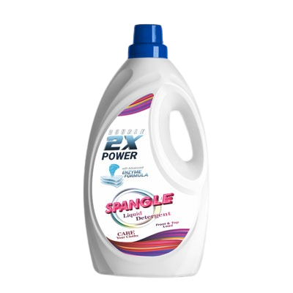
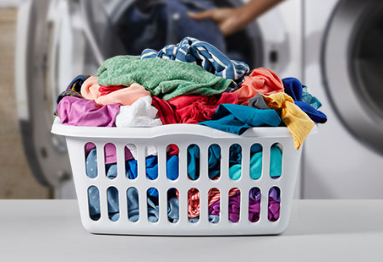
SPANGLE
LIQUID DETERGENT
DESCRIPTION & BENEFIT
Liquid Detergent has numerous benefits as well. Liquid Detergent has the key advantage of already being a liquid, which means that it dissolves immediately into the machine as the water starts to fill. Liquid Detergent is ideal for fully-automatic washing machines, and works well on coloured loads because it is gentler. The liquid detergent formula works to remove tough stains in 1 wash inside the machine, particularly grease stains.
HOW TO USE
Mix the Liquid Detergent with water as per your requirement and wash your clothes.

Slide 11
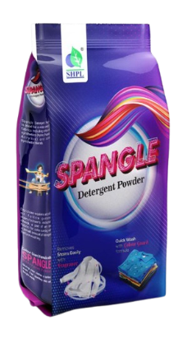

SPANGLE
DETERGENT POWDER
DESCRIPTION & BENEFIT
It possesses good cleansing power in both cold and warm water. It is readily soluble to give a good lather which does not quickly wear down. It does not contain substances that can harm fabrics or the user's hand.
HOW TO USE
Mix the Detergent Powder with water as per your requirement and wash your clothes.

Slide 12
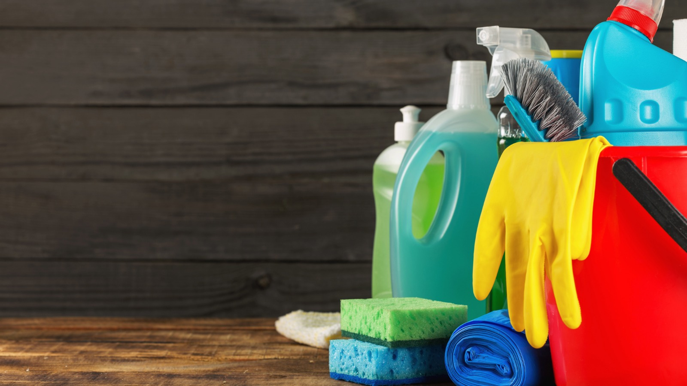
Thank You

