Slide 1



Slide 2
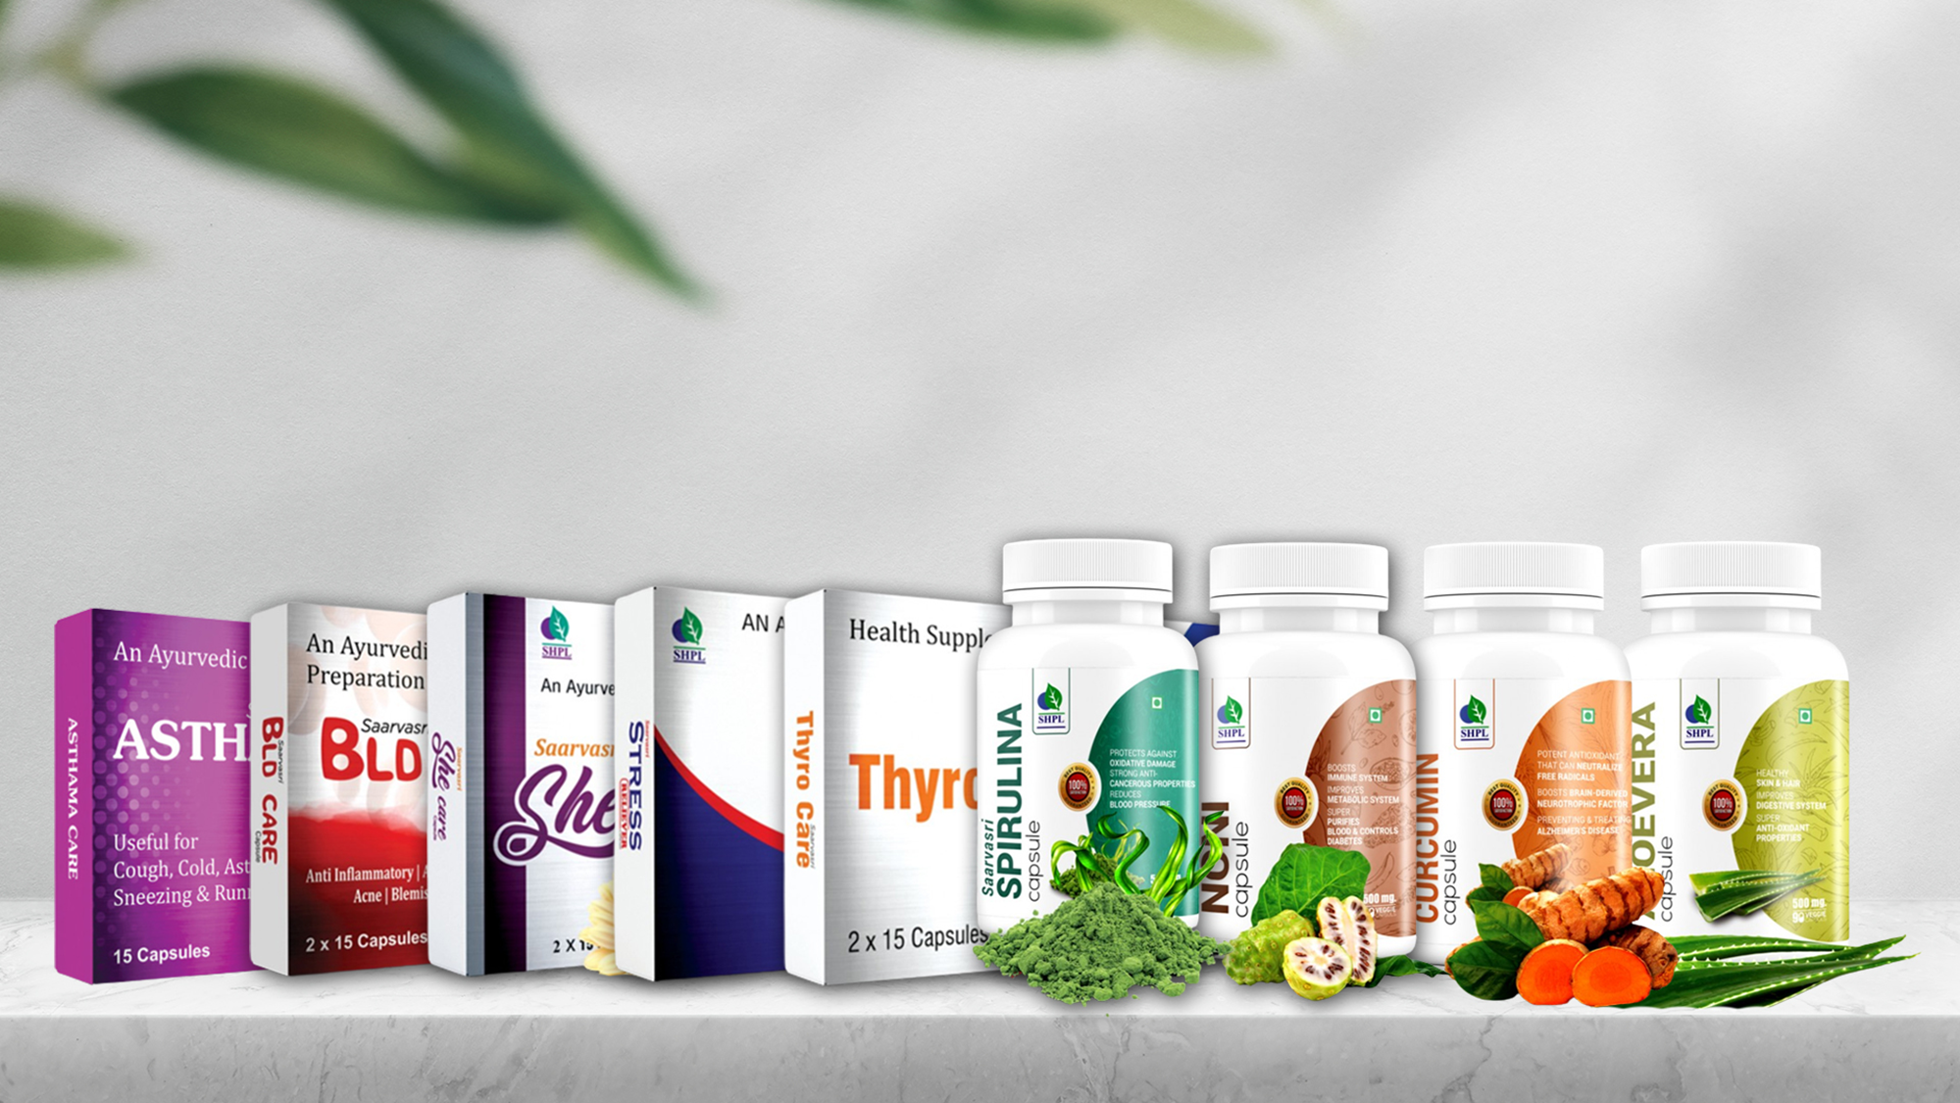

WELLNESS CAPSULES

Slide 3

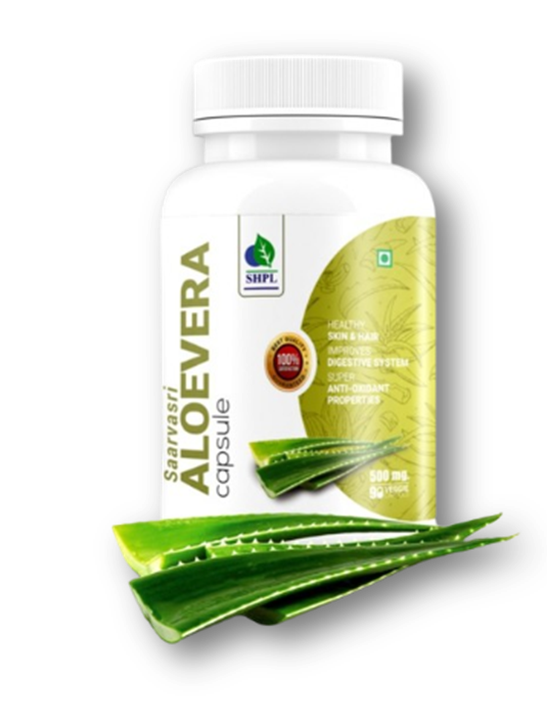
ALOEVERA CAPSULES
DESCRIPTION
Discover the soothing benefits of Saarvasri Aloe Vera Capsules, designed to promote digestive health and overall wellness. Packed with pure aloe vera extract, these capsules support a healthy digestive system, enhance skin health, and boost immunity naturally.
INGREDIENTS
Aloevera Barbadensis
BENEFITS
Improves your digestive system
Helps to prevent constipation
Heals wounds fast
Promotes healthy skin and hair
Enhances proper functioning in the body
It has super anti-oxidant properties
Detoxifies the body
Helpful for painful menstrual problems
Supports eye, bone and neural health
DOSAGE
1 to 2 capsules two times a day or as directed by the Experts.

Slide 4
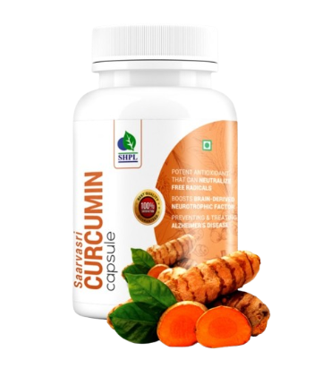
CURCUMIN CAPSULES
DESCRIPTION
Saarvasri Herbs Curcumin Capsule is a wonderful product made of curcumin. Curcumin is a natural component of the rhizome of turmeric (Curcuma longa) and its biological effects range from antioxidant, anti-inflammatory to inhibition of angiogenesis and is also shown to possess specific anti-tumoral activity.
INGREDIENTS
Curcumin extracted from Curcuma Longa
BENEFITS
Helps to boost Immunity
Can neutralize free radicals
Boosts brain-derived neurotropic factor, linked to improved brain function
Helps to lower risk of brain diseases
Helps to lower your risk of heart disease
May be useful in preventing Alzheimer's disease
Has incredible benefits against Depression
May help delay Aging and fight age-related chronic diseases
DOSAGE
1 to 2 capsules two times a day or as directed by the Experts.

Slide 5
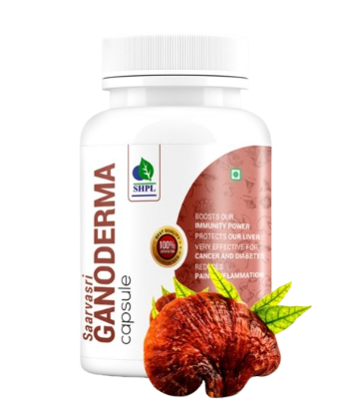
GANODERMA CAPSULES
DESCRIPTION
Saarvasri Herbs Ganoderma Capsule is made from Ganoderma Lucidum, commonly known as Reishi Mushroom, is frequently used in traditional Chinese medicines. There are over 36 bio-active nutritional compounds present in Ganoderma. It is rich in essential amino acids, beta-glucans, antioxidants, enzymes, minerals and vitamins.
INGREDIENTS
Ganoderma Lucidium Extract
BENEFITS
Boosts immunity power
Beneficial for skin
Reduces pain and inflammation
Helps to maintain Heart health
Flushes out toxins from body
Helpful for high blood pressure
Protects our Liver
Effective for lung infections, bronchitis and asthma
DOSAGE
1 to 2 capsules two times a day or as directed by the Experts.

Slide 6
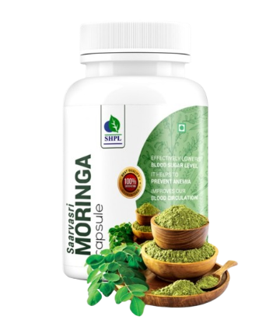
MORINGA CAPSULES
DESCRIPTION
Nourish your body with Saarvasri Moringa Capsules, packed with essential nutrients. These capsules support energy levels, enhance immunity, and promote overall wellness with the potent benefits of moringa leaves.
INGREDIENTS
Moringa Extract
BENEFITS
Lowers blood sugar level.
Helps to prevent anemia.
Helps to protect liver
Cleanses the body internally.
Helps to prevent cancer.
Relieves skin problems.
Improves our blood circulation.
Relieves any type of neural problems.
Effective for sexual problems.
Boosts immunity.
DOSAGE
1 to 2 capsules two times a day or as directed by the Experts.

Slide 7
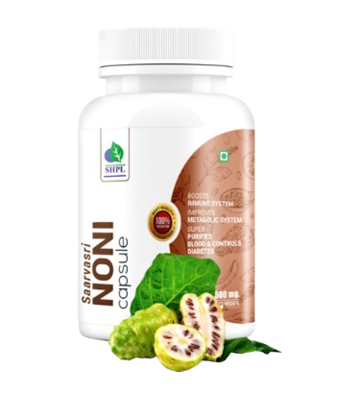
NONI CAPSULES
DESCRIPTION
Experience the natural healing power of Saarvasri Noni Capsules. Packed with essential nutrients and powerful antioxidants, these capsules support immune function, enhance digestion, and promote overall well-being. Elevate your health with the potent benefits of noni fruit.
INGREDIENTS
Noni Extract
BENEFITS
Regulates proper cell functioning
Rejuvenates the cells of the body & boosts Immune system
Improves metabolic system
Relieves pain as an analgesic
Facilitates sound sleep
Purifies blood
Improves arthritis ,asthma as well as respiratory and digestive problems
Improves circulatory system and Stabilizes Blood Pressure
Maintains healthy skin, hair and scalp.
DOSAGE
1 to 2 capsules two times a day or as directed by the Experts.

Slide 8
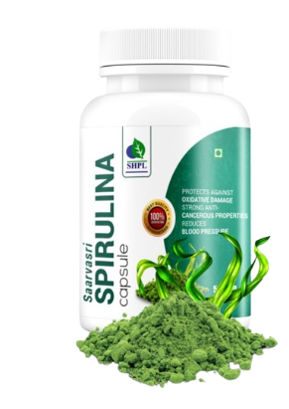
SPIRULINA CAPSULES
DESCRIPTION
Boost your energy and overall health with Saarvasri Spirulina Capsules. Rich in essential nutrients and antioxidants, these capsules support immune function, enhance energy levels, support brain health and promote detoxification for optimal health.
INGREDIENTS
Spirulina Extract
BENEFITS
It can lower “Bad” LDL and Triglyceride Levels.
It reduces Blood Pressure.
It is very effective for Anemia.
It improves Muscle Strength and Endurance.
It boosts up metabolism.
It prevents mal-nutrition.
It maintains our Neural and Mental health.
It is very helpful for Allergic patients.
It reduces Blood Pressure.
DOSAGE
1 to 2 capsules two times a day or as directed by the Experts.

Slide 9
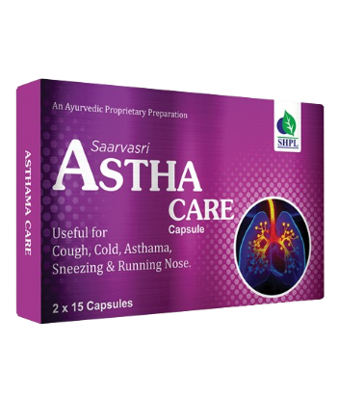
ASTHA CARE CAPSULES
DESCRIPTION
Introducing Saarvasri Astha Care Capsules, a natural supplement designed to support respiratory health and ease asthma symptoms. Made with a blend of potent, herbal ingredients, these capsules help reduce inflammation, improve lung function, and promote easier breathing. Breathe better with our Astha Care Capsules!
INGREDIENTS
Daruhaldar, Vasaka, Tulsi, Trikatu, Kantkari, Bharangmula, Swas Kutha Ras
BENEFITS
It prevents asthma attacks.
It maintains normal lung function.
It strengthens the immune system.
It relaxes the muscles of the breathing passages.
It helps to decrease the frequency of asthma attacks.
It reduces asthmatic symptoms like wheezing, shortness of breath, chest tightness etc.
DOSAGE
1 to 2 capsules two times a day or as directed by the Experts.

Slide 10
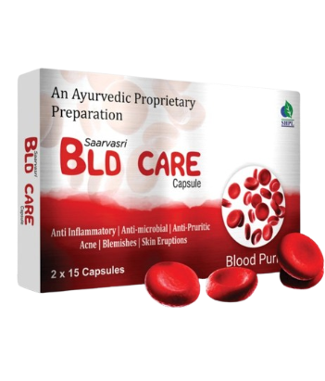
BLD CARE CAPSULES
DESCRIPTION
Cleanse and purify your blood with Saarvasri BLD Care Capsules. Formulated with powerful herbal ingredients, these capsules help detoxify the blood, support liver function, and promote clearer, healthier skin from within.
INGREDIENTS
Senna, Ipomea Turpethum, Rosae, Dalbergia Sissoo, Santalum Album, Giloy, Terminalia Chebula, Curcuma Zedoaria, Swertia Chirata, Cassia Occidentalis, Gorakmundi, Gentiana Kurroo, Colocasia Esculenta, Neem, Tulsi, Berberis Aristata, Sharpunkha, Bacopa Monnieri, Cassia Absus.
BENEFITS
It Purifies blood and flush out toxins from the body.
It is very beneficial for allergies.
It is very helpful in any kind of skin disorders.
It controls pimple, acne.
It maintains good blood circulation in the body.
It maintains liver health.
DOSAGE
1 to 2 capsules two times a day or as directed by the Experts.

Slide 11
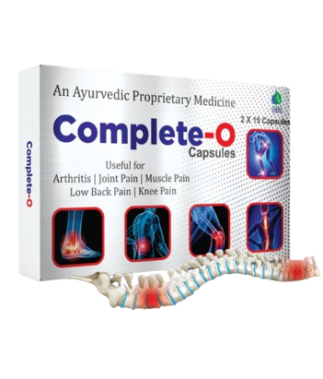
COMPLETE-O CAPSULES
DESCRIPTION
Relieve joint and muscle discomfort with Saarvasri Complete O Capsules. This herbal formulation is designed to ease joint pain, arthritis, muscle pain, low back pain, and knee pain, promoting improved mobility and comfort. Rediscover pain-free living with Complete O Capsules.
INGREDIENTS
Nirgudi Ext, Punarnava Ext, Jatamansi Ext, Shallaki Ext, devdaru, Haridra, Chopchini, Trikatu, Triphala, Maharasnadi, Sihnadi Guggul, Mahayograj Guggul, Vishtundaka Vati, Sameer Pannag Ras, Ajmodadi Churna, Sanjeevani Vati.
BENEFITS
It relieves pain.
It is very helpful in Arthritis and Osteo-Arthritis.
It is beneficial for our joint health.
It relieves muscle pain.
DOSAGE
1 to 2 capsules two times a day or as directed by the Experts.

Slide 12
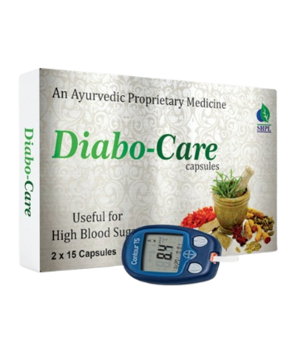
DIABO CARE CAPSULES
DESCRIPTION
Manage your blood sugar levels naturally with Saarvasri Diabo Care Capsules. This herbal formulation is designed to reduce high blood sugar, support healthy glucose metabolism, and promote overall well-being. Take control of your health with Diabo Care Capsules.
INGREDIENTS
Gudmar, Jamun, Karela, Kalmegh, Methi, Neem, Mamejava, Bilva, Kutaj, Chiraita, Vijaysar, Dalchini, Guduchi, Sarponkha, Haridra, Jeera, Triphala, Chandraprabha Vati, Yashad Bhasma.
BENEFITS
Helpful for lowering blood glucose level
Detoxifies the Pancreas and activates the beta-cells
Increasing the secretion rate of Insulin
Karela provides polypeptide-p or p-insulin which helps to activate our body insulin
Reduces sugar craving
Reduces the symptoms of Diabetes like frequent thirst and urination
Maintains general body health
Reduces weakness
DOSAGE
1 to 2 capsules two times a day or as directed by the Experts.

Slide 13
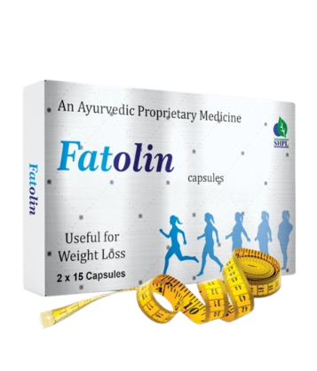
FATOLIN CAPSULES
DESCRIPTION
Saarvasri Herbs Fatolin Capsule is completely herbs based product which can effectively & naturally remove fat especially from the belly, Ankles and Arms. Thus help you to get in good shape in merely few days of use and in a natural way. It has similar results on men & women.
INGREDIENTS
Kokam, Garlic, Methi, Pippali, Senna, Agnimath, Kachnar, Trikatu, Trifala, Medohar, Arogyavardhini Vati.
BENEFITS
Enhance body metabolic rate
Regulates body digestive system
Helps in reducing the unnecessary fat deposition
Aids in Fat burning from Ankles, Arms and Belly
Help you to get in shape
Maintains the energy level throughout day
Naturally detoxifying the body
Maintains normal cholesterol levels
Reduces sugar & food craving
DOSAGE
1 to 2 capsules two times a day or as directed by the Experts.

Slide 14
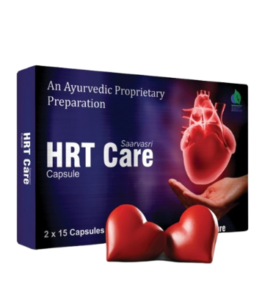
HRT CARE CAPSULES
DESCRIPTION
Saarvasri Herbs HRT Care Capsule is sourced from the highest quality and is made up of a proprietary blend of 100% natural herbs that may help in providing a healthy and strong heart without a pinch of side effect. It is a cardio tonic thus providing nutrition to heart muscles and strengthening them.
INGREDIENTS
Arjun, Lahsun, Ajmoda, Dalchini, Ashwagandha, Dadim, Chitrak, Trikatu, Triphala, Prabhakar Vati, Moti Pishti, Shewaga.
BENEFITS
It promotes Heart health.
Lowers high blood pressure level.
Aids in maintaining good cholesterol levels and lipid levels.
Helps improving HDL levels.
Helps to improve blood flow.
Promotes lowering of LDL levels.
They help in supporting heart from free radical damages caused by stress or strain.
DOSAGE
1 to 2 capsules two times a day or as directed by the Experts.

Slide 15
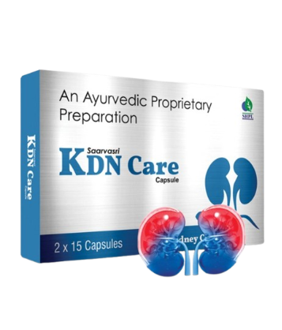
KDN CARE CAPSULES
DESCRIPTION
Saarvasri Herbs KDN Care capsule is very effective as it is sourced from the highest quality herbs and its concentrated by 100% natural process. These are formulated using natural extracts of various medicinal plants and are highly admired for side effect free feature.
INGREDIENTS
Punarnava, Pashanbhed, Gokhru, Palash, Jeera, Varun, Kultha, Sandevi, Arka, Lajjalu, Manjishtha, Apamarg, Nagarmotha, Hajrul Mahood Bhasma, Chandraprabha Vati, Shwet Parpati.
BENEFITS
Supports healthy urinary function, kidney function
Reduces Kidney stones.
Promotes flow of urine.
Inhibits formation of phosphate & calcium precipitates.
Helpful in urinary tract infections and other urinary problems.
Relieves inflammation of urethra.
Detoxifies and purifies the blood.
It prevents infection in kidney.
DOSAGE
1 to 2 capsules two times a day or as directed by the Experts.

Slide 16
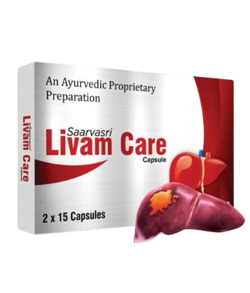
LIVAM CARE CAPSULES
DESCRIPTION
Livam Care Capsules contains different vital herbs in optimum concentration required to provide complete benefits to restore liver function parameters, which may help to check degeneration and promote regeneration of liver cells. Livam Care may have antiviral, antioxidant, anti-inflammatory and immune- modulator action.
INGREDIENTS
Sarpankho, Bala Seeds, Ghritakumari, Bhringaraj, Kutki chhal, Gulvel, Vavding Fruit, Kariyatu, Daruharidra
BENEFITS
Restores the functional efficacy of the liver by protecting the hepatic parenchyma.
Promotes hepatocellular regeneration.
Helpful in hepatitis.
Facilitates rapid elimination of toxins by proper metabolism
Ensures protection from alcohol induced hepatic damage.
Helps in preventing fatty infiltration of the liver.
If used before the onset of cirrhosis liver care arrests the progress of the disease and prevents further liver damage.
Helps to increase appetite, the digestion and assimilation process.
DOSAGE
1 to 2 capsules two times a day or as directed by the Experts.

Slide 17
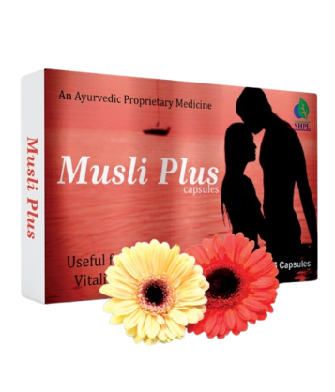
MUSLI PLUS CAPSULES
DESCRIPTION
Saarvasri Herbs Musli Plus is a premium natural formulation for general sexual health enhancement. It is formulated and designed to enhance sexual performance without unwanted side effects of prescription drugs.
INGREDIENTS
Safed Musli, Gokhru, Ashwagandha, Kaunch, Satavari, Mulethi, Javitri, Pippali, Akarkara, Salampanjha, Brahmi, Vidharikand, Dalchini, Jaiphal, Talamkhana, Makardhwaj, Shilajit, Vang Bhasma, Tamra Bhasma, Praval Bhasma, Kukkutandtwak Bhasma, Mukta Shukti Bhasma
BENEFITS
It instantly improves sexual energy, fights against sexual debility & sexual weakness.
It restores vitality and increases the stamina.
This product increases natural excitement, response to stimulation and give fantastic staying Energy and stamina for extended sexual performance.
It also significantly increases sex drive!
DOSAGE
1 to 2 capsules two times a day or as directed by the Experts.

Slide 18
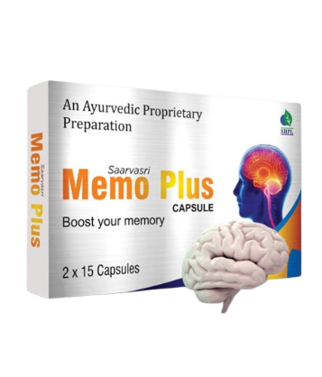
MEMO PLUS CAPSULES
DESCRIPTION
Saarvasri Herbs Memo Plus Capsule can be used by people of any age groups. If you are searching for a best natural memory enhancing product, this is a perfect choice. Unique blend of natural ingredients in this product boost brain power naturally without inducing any adverse action on user. It is found to be as an excellent solution to boost the functioning of brain .
INGREDIENTS
Convulvulus Pluricaulis, Asparagus Racemosus, Bacopa Monnieri, Eclipta Alba, Withania Somnifera, Celastrus Panicultus, Cassia Fistula, Acorus Calamus, Nardotachys Jatamansi
BENEFITS
It helps you to use your brain to the maximum level.
The more you use it, the more you'll challenge your brain to grow new cells.
It helps memory to response quickly and it is used as a brain tonic to enhance memory development.
It is reported to have blood flow in cerebral and neuro protective effects.
It has got anti-oxidant activity as well as it gives support to healthy immune system.
It prevents cerebral oxidative damage through its anti-oxidant product.
DOSAGE
1 to 2 capsules two times a day or as directed by the Experts.

Slide 19
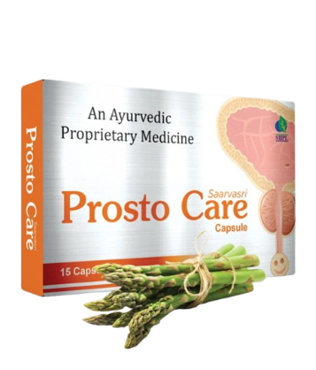
PROSTO CARE CAPSULES
DESCRIPTION
Saarvasri Herbs Prosto Care capsule is a perfect blend of many natural herbs to control any problem regarding our prostate and urination without any side effect. Prosto Care supports healthy prostate and normal male urogenital function. It improves urinary tract function and flow, reduces symptoms of enlarged prostate, supports healthy PSA levels and restores male energy.
INGREDIENTS
Varuna, Gokhru, Khus Khus, Gorakhmundi, Punarnava, Shatavari,Khadir, Salam Mishri, Lata Karanj, Shilajit, Kanchnar Guggul
BENEFITS
Beneficial for Urinary tract function and flow.
Reduces symptoms of enlarge prostate.
Support Healthy PSA level.
Restores Male Energy.
Supports Healthy prostate and normal male urogential function.
DOSAGE
1 to 2 capsules two times a day or as directed by the Experts.

Slide 20
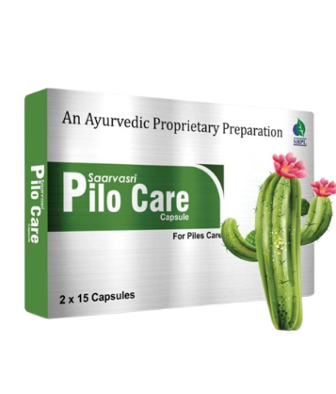
PILO CARE CAPSULES
DESCRIPTION
Piles is may be caused due to constipation, pregnancy, stomach problems etc. Saarvasri Herbs Pilo Care shrunken your piles and relieves discomfort. It soothes your itching and reduces inflammation. Give yourself freedom from the problem of piles by taking this piles care tablets infused with herbal ingredients. We use all natural and herbal ingredients for zero side effects.
INGREDIENTS
Commiphora Wighiti, Shilajit, Azadirachta Indica, Berberis Aristata, Emblica Officinalis, Terminalia Chebula, Terminalia Bellirica, Cassia Fistula, Bauhinia Variegata, Mesua Ferrea.
BENEFITS
May be helpful in Chronic constipation, Hemorrhoids, fissure, bleeding and non-bleeding piles, fistula, internal and external piles, painful defecation, rectal inflammation, peri-anal abscess, rectal prolapse.
Effective solution for the vein and capillary health of the anal passage.
Helps in maintaining the regular routine circulation.
Specifically formulated for treatment of external hemorrhoids, internal hemorrhoid and prolapsed hemorrhoid.
It has anti-inflammatory properties, and is fast in penetrating body tissues.
DOSAGE
1 to 2 capsules two times a day or as directed by the Experts.

Slide 21
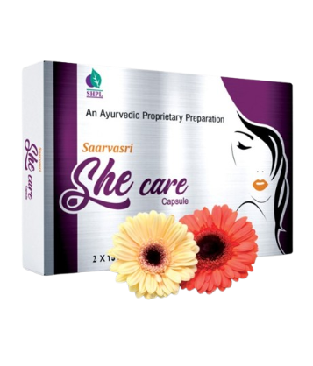
SHE CARE CAPSULES
DESCRIPTION
Female power and performance tends to fluctuate with time and age. It is a common fact because, with age, hormone levels and general desire in women isknown to reduce. But most products are focused on men. With Saarvasri Herbs She Care capsule, females now can find a complete solution for their satisfied happy life. It is made with 100% natural ingredients.
INGREDIENTS
Shatavari, Akarkara, Ashwagandha, Gokhuru, Arjuna, Shuddh Shilajit, Vaang Bhasma, Abhrak Bhasma, Swarna Bhasma, Rasasindur.
BENEFITS
It helps to increase libido and sexual desire in women.
It boosts their stamina and performance.
It maintains daily energy level.
Protects reproductive organs.
DOSAGE
1 to 2 capsules two times a day or as directed by the Experts.

Slide 22
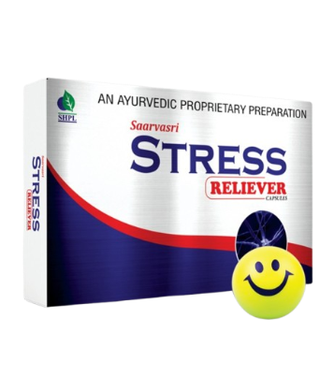
STRESS RELIEVER CAPSULES
DESCRIPTION
Saarvasri Herbs Stress Reliever Capsule has an anti-stress formula used to reduce stress or tension. Stress Reliever Capsules are purely herbal remedy made from natural and effective herbs. It is a natural way to keep a calm mind and enjoy all moments of life.
INGREDIENTS
Shankhpuspi, Brahmi, Sarpagandha, Tagar, Triphala, Ashwagandha, Jatamansi.
BENEFITS
It calms the mind and helps to reduce tension or stress naturally and safely.
It also protects the heart and brain.
It provides anti-oxidants support and also boosts immunity.
It relieves nerve disorders.
ü It is very effective to control headache.
DOSAGE
1 to 2 capsules two times a day or as directed by the Experts.

Slide 23
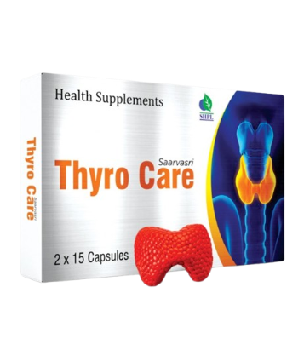
THYRO CARE CAPSULES
DESCRIPTION
Saarvasri Herbs Thyro Care is an excellent combination of different herbs which can be extremely helpful not only in managing the symptoms of both hypothyroidism and hyperthyroidism, but they can also be an important part of restoring someone's health back to normal.
INGREDIENTS
Licorice, Ashwagandha, Bacopa Monneri, Black Walnut, Flax Seed, Guggul
BENEFITS
Acts as a thyroid stimulant.
Reduces the weight gained due to thyroid malfunction.
Regularizes the menstrual cycles and cleanses the genito-urinary system.
Diuretic and anti-inflammatory in action helps cure edema.
Restores the lost vitality and energy levels.
Enhances skin and hair tone.
Safe and effective- for long term usage.
DOSAGE
1 to 2 capsules two times a day or as directed by the Experts.

Slide 24
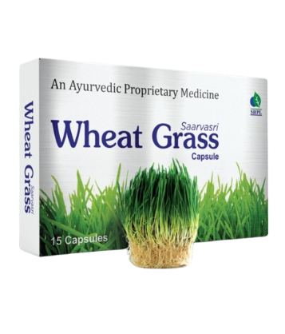
WHEAT GRASS CAPSULES
DESCRIPTION
High in Nutrients and Antioxidants, Saarvasri Herbs Wheatgrass Capsules is an excellent source of many different vitamins and minerals. Wheatgrass is the fresh sprouted leaves of the wheat plant. Wheatgrass is a source of potassium, dietary fiber, vitamin A, vitamin C, vitamin E, vitamin K, thiamin, riboflavin, niacin, vitamin B6, iron, zinc, copper, manganese, and selenium. Wheatgrass is also a good source of essential Amino Acids.
INGREDIENTS
Wheat Grass Extract
BENEFITS
Detoxifies body & increases body metabolism
Helps to loose weight
Effective for skin & hair
Helpful in anemia & increases platelet counts
Increases sperm count
Effective for digestive system
Protects our liver, heart and all the system of our body.
Effective for any kind of neural disorders.
DOSAGE
1 to 2 capsules two times a day or as directed by the Experts.

Slide 25
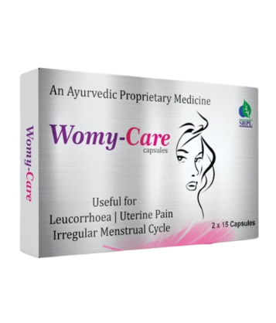
WOMY CARE CAPSULES
DESCRIPTION
Saarvasri Herbs Womy Care capsule is a complete solution for women for their many health problems. It is enriched with natural wonderful herbs. This product is very beneficial for menstrual problems in women along with that leucorrhea, cyst, energy loss etc.
INGREDIENTS
Lodhra, Ashok, Manjistha, Shatavari, Ashwagandha, Nagkeshar, Draksha, Kutaj, Mochras, Saunth, Ghritakumari, Guduchi, Kakamchi, Vanshalochan, Chikni Supari, Ulat Kambal, Tankan Bhasma, Mandoor Bhasma
BENEFITS
Immunity booster
Support Blood circulation & increases Hemoglobin
Helps in irregular menstruation, dysmenorrhea, abnormal menstruation
Controls ovary cyst
Helps in detoxification
Relief for Gas Indigestion
Helps to boost energy level
Maintains healthy skin
DOSAGE
1 to 2 capsules two times a day or as directed by the Experts.

Slide 26

WITH THE REGULAR USE OF SOME SHPL HEALTH CARE PRODUCTS
TAKE CARE
OF YOURSELF

