Slide 1



Slide 2
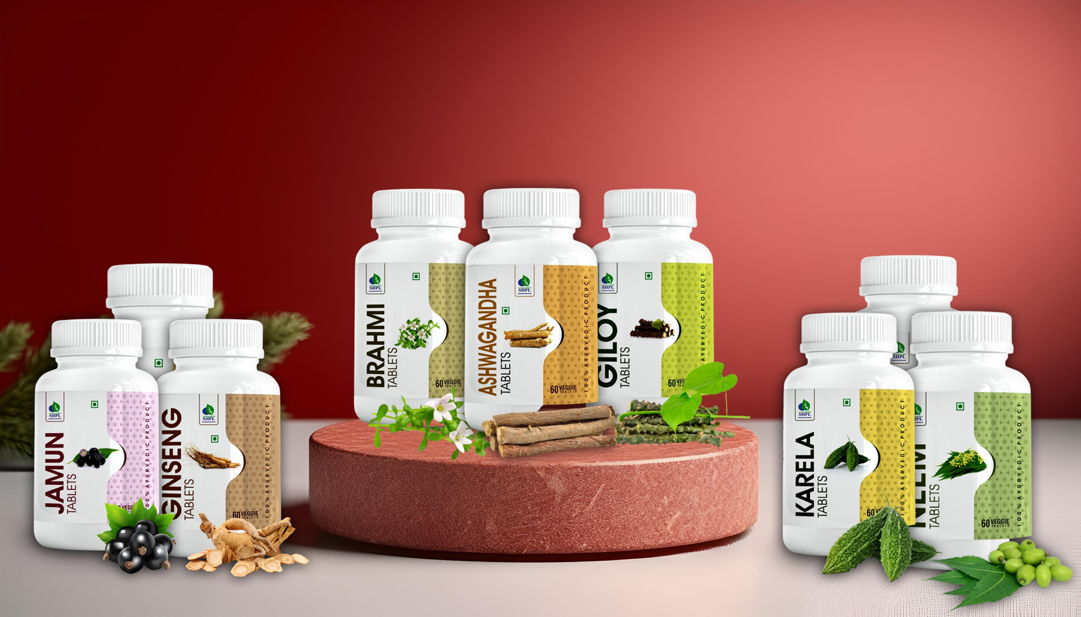
AYURVEDIC HERBAL TABLETS

Slide 3

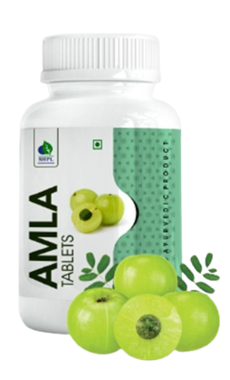
AMLA TABLETS
DESCRIPTION
Amla, also known as Indian gooseberry, has gained a following throughout the world as a "superfruit." It's no surprise — a 100-gram serving of fresh amla berries contains as much vitamin C as 20 oranges, twice the antioxidant power of acai berry, and around 17 times that of a pomegranate. Saarvasri Amla Tablet is a powerhouse of Antioxidants. It is low on calories and loaded with a host of phenolic phytochemicals like flavonoids, anthocyanins and a potent source of vitamin C and A.
INGREDIENTS
Amla Extract
BENEFITS
Boosts immunity
Reduces Hyperglycemia
Has lipid-lowering properties
Powerful anti-oxidant
Supports respiratory system
Strengthens the nervous system
Improves eyesight
Improves digestion and bowel movements
DOSAGE
Take 1 tablet twice daily or as directed by experts.

Slide 4
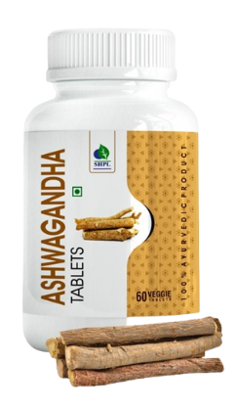
ASHWAGANDHA TABLETS
DESCRIPTION
Amla, also known as Indian gooseberry, has gained a following throughout the world as a "superfruit." It's no surprise — a 100-gram serving of fresh amla berries contains as much vitamin C as 20 oranges, twice the antioxidant power of acai berry, and around 17 times that of a pomegranate. Saarvasri Amla Tablet is a powerhouse of Antioxidants. It is low on calories and loaded with a host of phenolic phytochemicals like flavonoids, anthocyanins and a potent source of vitamin C and A.
INGREDIENTS
Ashwagandha Extract
BENEFITS
Helps to reduce stress and anxiety
Helpful in reducing the symptoms of depression
Can increase testosterone and fertility in men
May improve brain function and can increase memory power
Can boost our immunity power
Very helpful in insomnia
Increases our stamina and maintains our daily energy
DOSAGE
Take 1 tablet twice daily, 15-30 minutes after meal or as directed by experts.

Slide 5
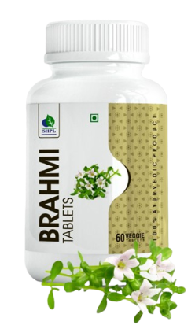
BRAHMI TABLETS
DESCRIPTION
Brahmi is a perennial herb most well known for its memory enhancing property. There are certain valuable nutritional properties like antioxidants, vitamins, minerals, fibers, alkaloids and triterpene saponins found in brahmi that have strong effects on the body. Saarvasri Brahmi Tablets are 100% natural nutritional supplement loaded with the powerful health benefits of Brahmi.
INGREDIENTS
Brahmi Extract
BENEFITS
Helps relieve anxiety.
Enhance brain functions
Improves memory
Helps prevent Alzheimer’s Disease.
Helps manage depression.
Contains powerful antioxidants.
Anti-inflammatory properties.
Helps reduce ADHD symptoms.
Helps lower blood pressure levels
DOSAGE
Take 1 tablet twice daily or as directed by experts.

Slide 6
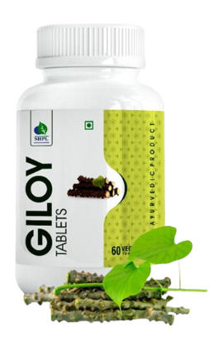
GILOY TABLETS
DESCRIPTION
Giloy (Tinospora cordifolia) is a climbing shrub that grows on other trees. It is considered as an essential herbal plant in Ayurvedic classical medicine, where people use it as a treatment for a wide range of health conditions. Giloy is also called Guduchi or Amrita in Sanskrit. In Sanskrit, “guduchi” means something that protects the whole body, and “amrita” means immortality. Giloy is packed with some wonderful nutrients and has some effective health benefits.
INGREDIENTS
Giloy Extract
BENEFITS
An excellent immune booster
Has a calming effect on the body
A powerful anti-oxidant
Helps lowering blood sugar and cholesterol.
Protects the liver, heart, nervous system
Helps relieve pain
Anti-pyretic (reduces fever)
DOSAGE
Take 1 tablet twice daily, 15-30 minutes after meal or as directed by experts.

Slide 7
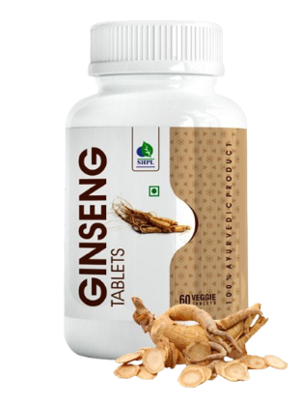
GINSENG TABLETS
DESCRIPTION
Saarvasri Ginseng is a wonderful classical product with numerous nutritional properties within it. People have traditionally taken ginseng to help with a range of medical conditions.. Ginseng contains two significant compounds: ginsenosides and gintonin. Researchers believe that these compounds complement one another to provide health benefits.
INGREDIENTS
Ginseng Extract
BENEFITS
Helps improve brain functions like memory, behavior and mood
Helps improve Erectile Dysfunction
Boosts immunity by improving immune markers
regulate inflammation
help fight fatigue and enhance physical activity
DOSAGE
Take 1 tablet twice daily, 30 minutes before meal or as directed by experts.

Slide 8
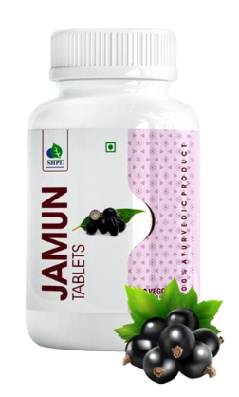
JAMUN TABLETS
DESCRIPTION
Jamun, the highly nutritious, refreshing and succulent fruit flooding the summer markets has innumerable health benefits. Jamun is an excellent source of vitamin C, carbohydrates, protein, iron, magnesium, potassium and few phytochemicals. The fruit is diuretic, anti- scorbutic and carminative in properties and is a rich source of polyphenolic compounds.
INGREDIENTS
Jamun Extract
BENEFITS
Natural Hypoglycaemic
increases the insulin levels in the body
Reduces triglycerides and LDL
Improves hemoglobin count
Helps in obesity management and metabolic syndrome.
Helps maintain bone health, prevents diarrhea, and excessive urination
DOSAGE
Take 1 tablet twice daily, 15-30 minutes after meal or as directed by experts.

Slide 9
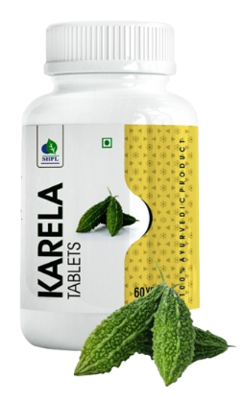
KARELA TABLETS
DESCRIPTION
SHPL Karela Tablets are loaded with countless health benefits. Karela is rich in fibre and has zero cholesterol. The vitamins and minerals in this vegetable are much higher when compared to other green vegetables that are popularly available. Karela is packed with calcium, phosphorus, iron, Vitamin C and small amounts of Vitamin B complex. Karela has excellent medicinal virtues.
INGREDIENTS
Karela Extract
BENEFITS
Helps lower blood sugar levels
Helps to bring glucose into the cells
Improves sugar metabolism.
Anti-oxidant
Improves vision.
Promotes skin health.
Helps in metabolic syndrome.
Natural blood purifier
Effective in treating skin infections
DOSAGE
Take 1 tablet twice daily, 15-30 minutes after meal or as directed by experts.

Slide 10
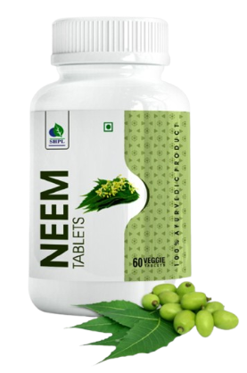
NEEM TABLETS
DESCRIPTION
Azadirachta indica, commonly known as neem, has been used traditionally for the treatment of inflammation, infections, fever, skin diseases and dental disorders. Saarvasri Neem Tablets have been demonstrated to exhibit immunomodulatory, anti-inflammatory, antihyperglycaemic, antiulcer, antimalarial, antifungal, antibacterial, antiviral, antioxidant, antimutagenic and anticarcinogenic properties.
INGREDIENTS
Neem Extract
BENEFITS
Anti-inflammatory properties
Antioxidant, antimicrobial, antiparasitic, antidiabetic
Helps fight oxidative stress
Helps fight liver disease
Promotes healthy skin
Helps lower blood sugar levels
Prevents skin disease
DOSAGE
Take 1 tablet twice daily, 15-30 minutes after meal or as directed by experts.

Slide 11
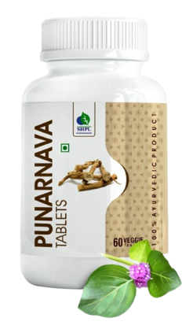
PUNARNAVA TABLETS
DESCRIPTION
Punarnava which literally translates into ‘something that renews or replenishes the body ’is a traditional ayurvedic plant that is used to rejuvenate the whole body. Punarnava is a treasure trove of nutrients like proteins, vitamin C, sodium, calcium, iron and bioactive components. Saarvasri Punarnava Tablets are 100% natural and have numerous health benefits.
INGREDIENTS
Punarnava Extract
BENEFITS
Beneficial in reducing joint and muscle pain
Beneficial in reducing inflammation in irritable bowel syndrome and ulcerative colitis
Prevents urinary distension, kidney stones and painful urination
Plays a key role in burning excess fat
Washes out the excess fluids and harmful toxins from the body
Strengthens the heart muscles, lowers cholesterol levels in the blood and prevents lipid build-up
Stimulates the production of reproductive hormones in both men and women
DOSAGE
Take 1 tablet twice daily or as directed by experts.

Slide 12
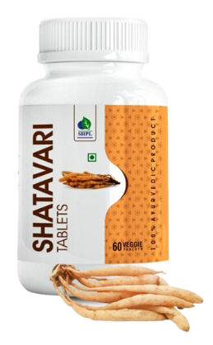
SHATAVARI TABLETS
DESCRIPTION
Shatavari is extremely beneficial for women's reproductive health throughout all stages of their life. Shatavari helps in reducing mental stress and anxiety and stimulates the hormones for increasing libido in both men and women. Shatavari possesses cooling, calming properties that can help to soothe and balance your body. It also has rejuvenating and nourishing effects.
INGREDIENTS
Shatavari Extract
BENEFITS
Supports reproductive health (fertility)
Improves hormonal balance and energy levels in women
Reduces menopausal symptoms
Improves sexual potency
Helps rejuvenate and nourishes both body and mind
Improves vitality
Helps to improve sperm count, shape, mobility, and volume in men
DOSAGE
Take 1 tablet twice daily 15-30 minutes after meal or as directed by experts.

Slide 13
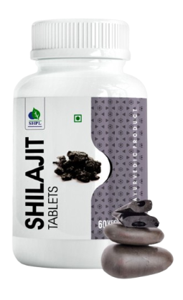
SHILAJIT TABLETS
DESCRIPTION
Shilajit is one of many herb and mineral formulations (Rasaoushadhies) used in Ayurveda, a healing system that originated thousands of years ago in India. Shilajit has been used in traditional herbal medicine to treat a wide variety of conditions, ranging from bone fractures to impotence. Shilajit is composed mainly of humic substances, including fulvic acid, that account for around 60% to 80% of the total nutraceutical compound plus some oligoelements including selenium of antiaging properties.
INGREDIENTS
Shilajit Extract
BENEFITS
Prevent or slow Alzheimer’s disease
Raise testosterone
Treat chronic fatigue syndrome
Support heart health
Improves body's immunity and memory
An energy booster
Helps sustain penile erection
Effective in treating male infertility by increasing total sperm count and motility
DOSAGE
Take 1 tablet twice daily 15-30 minutes after meal or as directed by experts.

Slide 14
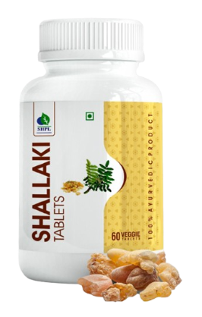
SHALLAKI TABLETS
DESCRIPTION
Ease joint discomfort with Shallaki Tablets. These tablets support joint mobility and flexibility, promoting overall joint health. Shallaki is also known for its anti-inflammatory properties, which help reduce pain and support cartilage health, making it ideal for those with joint issues.
INGREDIENTS
Shallaki Extract
BENEFITS
Helps in managing Rheumatoid Arthritis and Osteoarthritis
Reduces the pain and inflammation in the joints.
Reduces the risk of heart disease.
May help inhibit cancer growth.
Effective in treating IBD- Crohn’s disease and Ulcerative Colitis.
DOSAGE
Take 1 tablet twice daily 15-30 minutes after meal or as directed by experts.

Slide 15
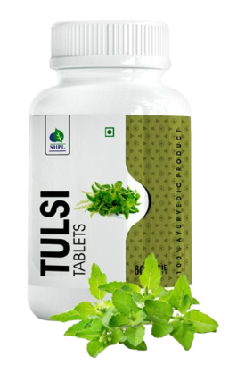
TULSI TABLETS
DESCRIPTION
Hindu people worship holy basil. It's considered the "Mother Medicine of Nature." It’s been revered since ancient times as an herb that can promote a healthy body, mind, and spirit. The sacred plant is often planted around Hindu shrines. The name tulsi means "the incomparable one”. Studies show holy basil has a wide range of health-promoting properties. It's an: Adaptogenic, Anti-arthritic, Anti-coagulant, Anti-diabetic, Anti-inflammatory, Anti-pyretic (prevents fever), Antidiarrheal, Antimicrobial (including antibacterial, antiviral, antifungal, and more), Antioxidant, Antitussive (treats cough), Liver-, brain-. and heart-protectant.
INGREDIENTS
Tulsi Extract
BENEFITS
Immune booster, anti-bacterial and anti-viral.
Helps eradicate cold, cough, sore throat, running nose.
Helps reduce acidity, constipation and stomach ache.
Reduces fever.
Benefits the respiratory system by clearing congestion.
DOSAGE
Take 1 tablet twice daily, 30 mins before meal or as directed by experts

Slide 16
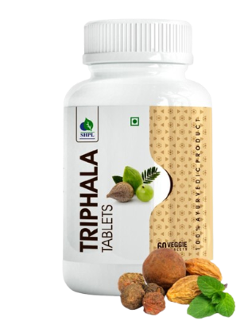
TRIPHALA TABLETS
DESCRIPTION
This ancient ayurvedic formulation consists of three medicinal fruits that are Amalaki (Phyllanthus Emblica), Bahera (Terminalia Bellirica), and Haritaki (Terminalia Chebula). This contains a rich source of vitamin c along with many important nutrients to the body.
INGREDIENTS
Amlaki Ext., Haritaki Ext. & Bahera Ext
BENEFITS
Supports digestive health
Prevents constipation
Controls uric acid
Regulates blood sugar levels
Helps in weight loss
Anti-inflammatory
Helps prevent cancer
Improves liver function
Protects the heart
DOSAGE
Take 1 tablet twice daily, 30 mins before meal or as directed by experts

Slide 17
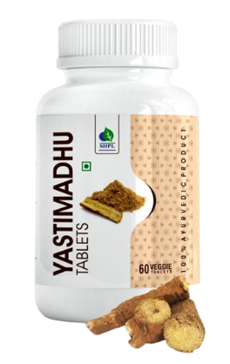
YASTHIMADHU TABLETS
DESCRIPTION
Mulethi is also called Yashtimadhu in Ayurveda. It is an important herb used in Indian medicines, home remedies, folk medicines and Ayurveda. Soothe digestive discomfort with Yastimadhu Tablets. Known for their anti-inflammatory properties, these tablets support digestive health and comfort. Yastimadhu also helps in reducing acidity, promoting respiratory health, and enhancing immune function, making it a comprehensive health aid.
INGREDIENTS
Yasthimadhu Ext.
BENEFITS
Has anti-microbial and anti-viral properties.
Supports healthy respiratory system.
Helps treat heartburn, GERD, peptic ulcers and gastritis
Helps in dry and wet cough
Reduces inflammation in the bronchial tubes.
DOSAGE
Take 1 tablet twice daily, 30 mins before meal or as directed by experts

Slide 18

WITH THE REGULAR USE OF SOME SHPL HEALTH CARE PRODUCTS
TAKE CARE
OF YOURSELF

