Slide 1



Slide 2
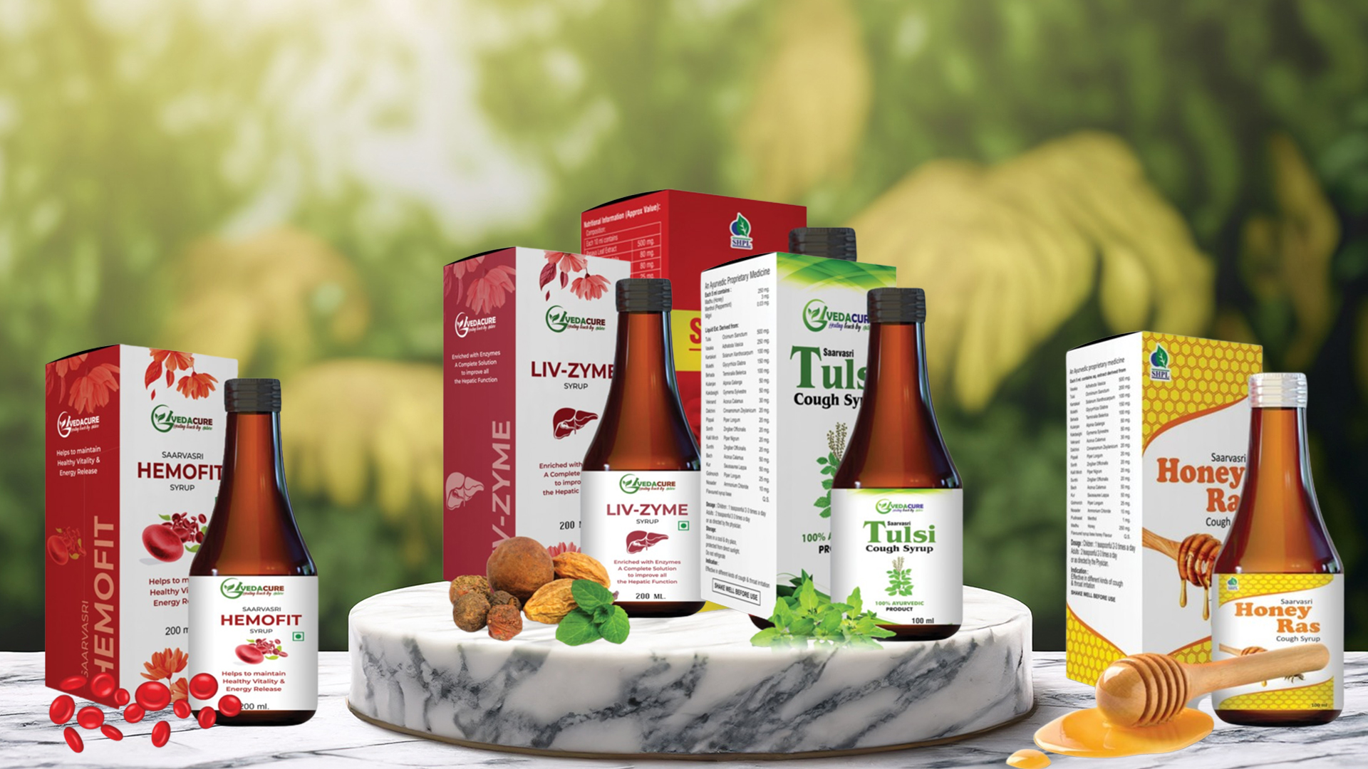
WELLNESS SYRUPS

Slide 3

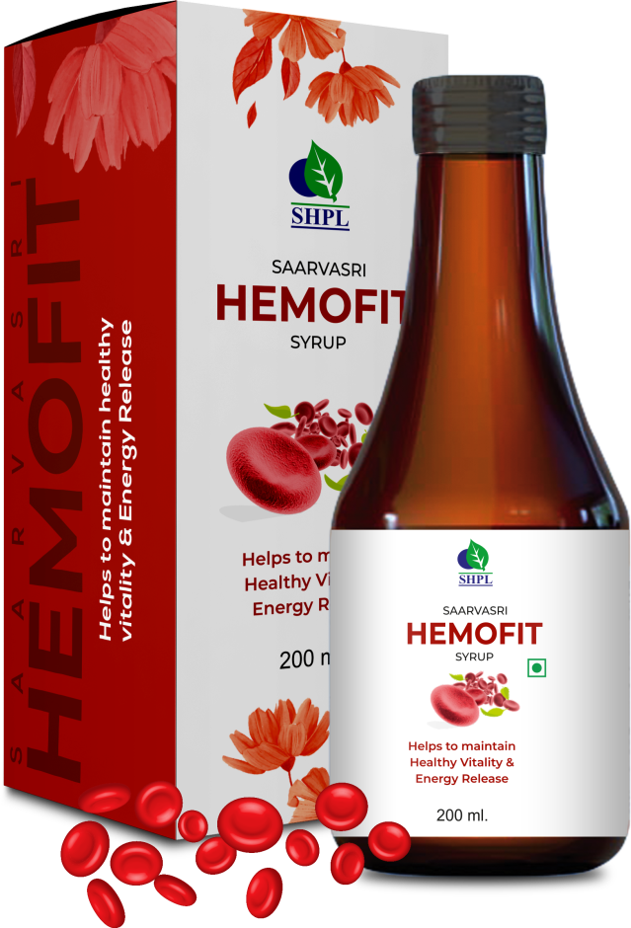
HEMOFIT SYRUP
DESCRIPTION
Hemofit syrup tends to stimulate blood cell formation, increasing the hemoglobin in the blood to prevent Anemia. Hemoglobin is an iron-containing protein in your red blood cells that carries oxygen to your body's organs and tissues and transports carbon dioxide from your organs and tissues back to your lungs. Anemia is a decrease in the total amount of red blood cells (RBCs) or hemoglobin in the blood or a lowered ability of the blood to carry oxygen.
INGREDIENTS
Basana, Jeera, Saunf, Soya, Ashwagandha, Khubkalan, Anantmool, Manjishtha, Elaichi , Brahmi, Datstraw, Navasar, Satava Nimbo, Lohasav (R.T.S.), Limewater.
BENEFITS
Helps to formation of blood cells in the process of hematopoiesis.
Improves to carry adequate oxygen to your body's tissues to overcome hypoxia.
Take care Irregular heartbeats.
Rectification of Shortness of breath.
Controls Pain in your bones, chest, belly, and joints.
Unintended movement in the lower leg (restless legs syndrome).
DOSAGE
10 to 15ml twice a day or as per advise of health provider.

Slide 4
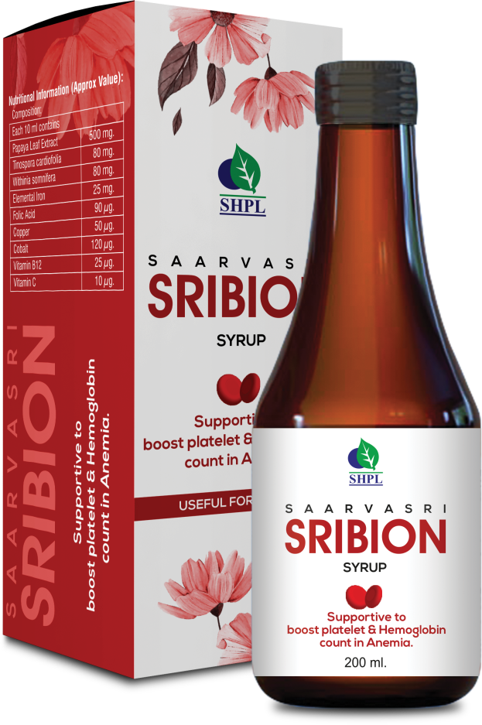
SRIBION SYRUP
DESCRIPTION
Anemia is a common problem especially among females that often becomes the cause of weakness and exhaustion in them. Saarvasri Herbs Sribion Syrup is an amazing product for Iron Deficiency & Anemia which is a combination of naturally processed iron and essential herbs like Papaya Leaf etc. that are helpful in treating iron deficiency and Anemia as recommended by Ayurveda.
INGREDIENTS
Papaya Leaf Extract, Giloy, Ashwagandha.
BENEFITS
To boost platelet & Hemoglobin count in Anemia.
Supportive in the treatment of Chemotherapy.
To regulate Liver functioning & immunomodulation.
Supportive in the treatment of Flu & Liver.
DOSAGE
10 to 15ml twice a day or as per advise of health provider.

Slide 5
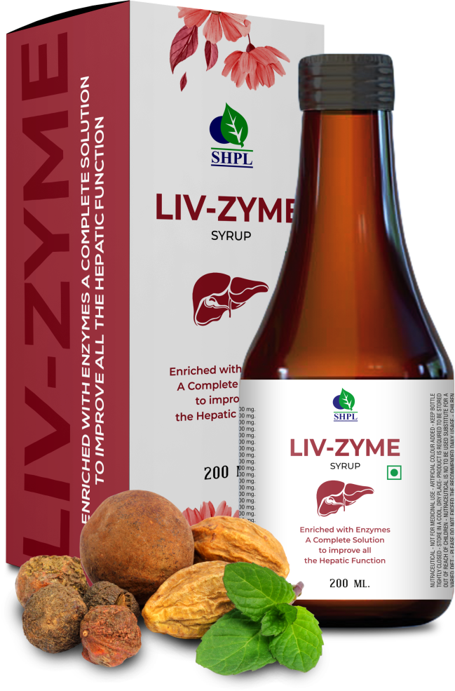
LIV-ZYME SYRUP
DESCRIPTION
Saarvasri Herbs Liv-zyme contains digestive enzymes, which are natural substances needed by the body to help break down and digest food. It is used when the pancreas cannot make or does not release enough digestive enzymes into the gut to digest the food.
INGREDIENTS
Bhringaraj, Sarpunka, Rohitak, Arjun, Ashwagandha, Kalmegh, Makoi, Vidang, Pitt papra, Bhumi Amla, Daru Haldi, Punarnava, Tulsi, Kasni, Giloy, Triphala, Chitrak Mool.
BENEFITS
Constipation
General digestive problems
Loss of appetite
Indigestion
Flatulence
Dyspepsia
DOSAGE
10 to 15ml twice a day or as per advise of health provider.

Slide 6
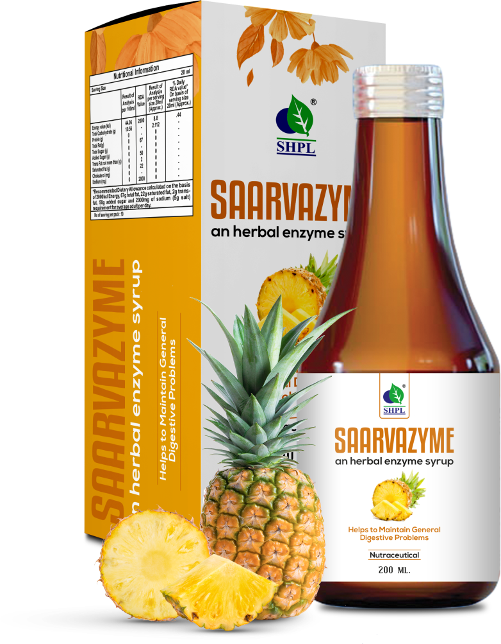
SAARVAZYME SYRUP
DESCRIPTION
Saarvasri Herbs Saarvazyme is a very good digestive syrup with the help of Pineapple to relieve any kind of digestive problems . It contains digestive enzymes, which are natural substances needed by the body to help break down and digest food. It is used when the pancreas cannot make or does not release enough digestive enzymes into the gut to digest the food.
INGREDIENTS
Bhringaraj, Sarpunka, Rohitak, Arjun, Ashwagandha, Kalmegh, Makoi, Vidang, Pitt papra, Bhumi Amla, Daru Haldi, Punarnava, Tulsi, Kasni, Giloy, Triphala, Chitrak Mool.
BENEFITS
Constipation
General digestive problems
Loss of appetite
Indigestion
Flatulence
Dyspepsia
DOSAGE
10 to 15ml twice a day or as per advise of health provider.

Slide 7
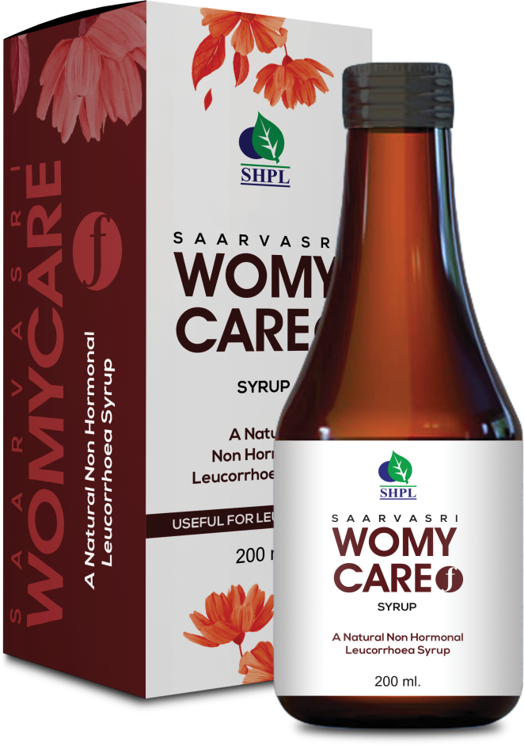
WOMY CARE-F SYRUP
DESCRIPTION
Saarvasri Herbs Womy Care Syrup is multifactorial product for woman health which is very much effective in many ailments. Womy Care Syrup is enriched with seventeen (17) wonderful natural ingredients. Saarvasri Herbs Womy Care syrup is powerful uterine tonic.
INGREDIENTS
Ashoka, Lodhra, Dhatki Pushpa, Amla, Bahera, Hareetaki, Sunthi, Amrasthi, Mustaka, Chandan Rakta, Safed Jeera, Daruharidra, Vasaka, Pippali, Neelkumari, Manjistha, Shahad
BENEFITS
Helpful in Leucorrhea
Normalizes Hormonal balance
Takes care of menstrual problems
Effective against irregular menstrual cycles.
Helps in easy flow during the menstrual cycle.
Relieves pain in endometriosis.
Reduces reproductive problems like cysts and fibroids.
A powerful uterine tonic and reduces cramps.
DOSAGE
10 to 15ml twice a day or as per advise of health provider.

Slide 8
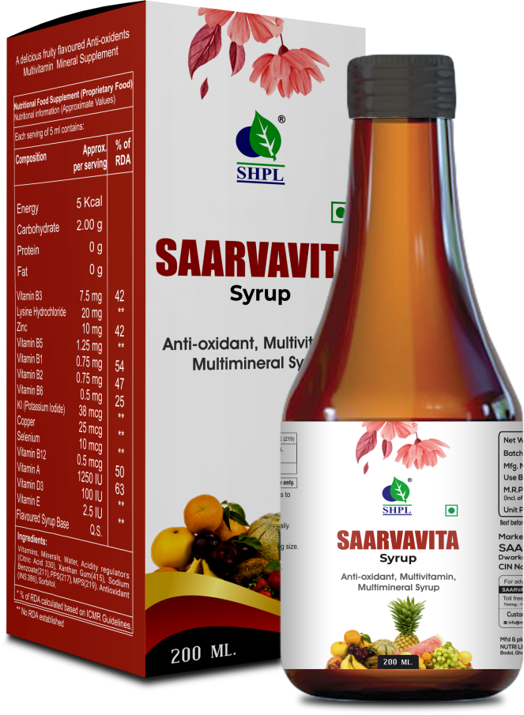
SAARVAVITA SYRUP
DESCRIPTION
Introducing SHPL Saarva Vita Syrup, a comprehensive antioxidant, multivitamin, and multimineral formula designed to nourish your body from within. Packed with a powerhouse blend of essential vitamins and minerals, including Vitamin A, B1, B2, B3, B5, B6, B12, D, E, Copper, Zinc, Selenium, Lysine Hydrochloride, and Potassium Iodide, this syrup offers a multitude of health benefits.
INGREDIENTS
Vitamin A, B1, B2, B3, B5, B6, B12, D, E, Copper, Zinc, Selenium, Lysine Hydrochloride, and Potassium Iodide, Flavoured Syrup Base.
BENEFITS
An anti-oxidant, multi-vitamin, Multi-mineral syrup that helps restore energy levels.
Helps promote general health and well-being.
Provides sustainable & continued energy.
DOSAGE
10 to 15ml twice a day or as per advise of health provider.

Slide 9
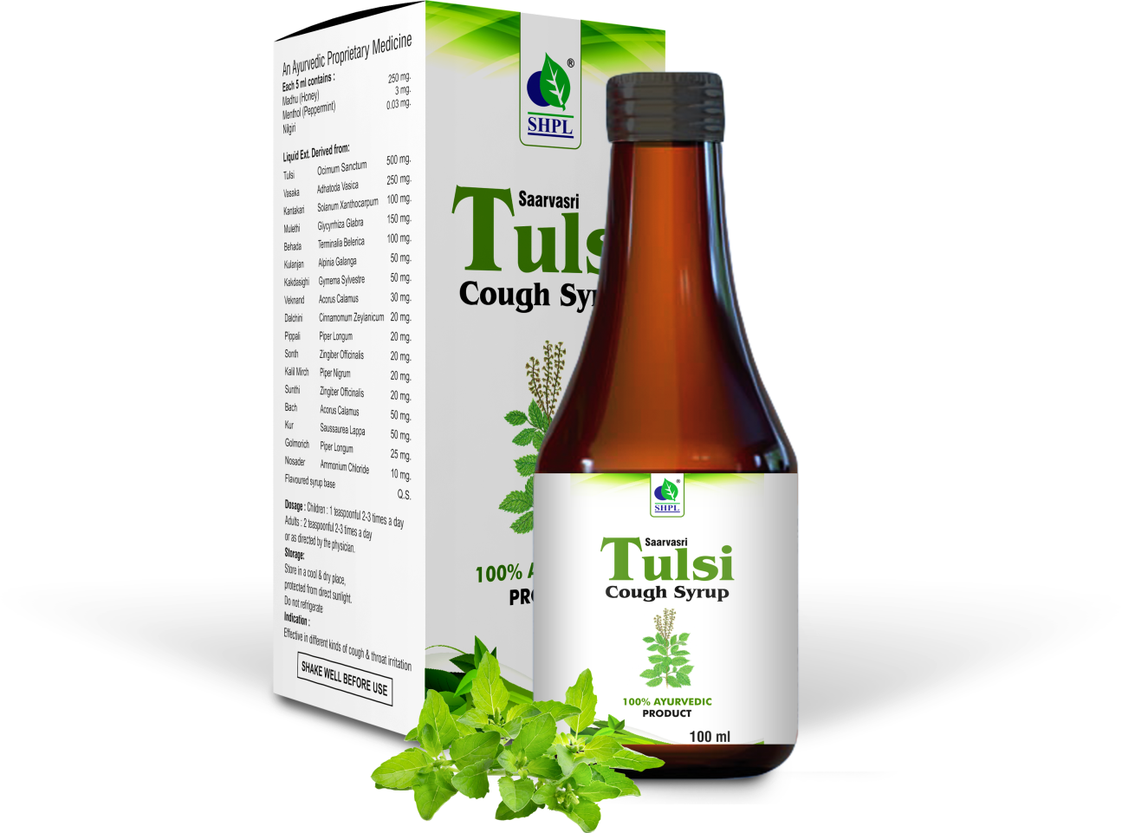
TULSI COUGH SYRUP
DESCRIPTION
Saarvasri Herbs Cough Care is used to relieve coughs caused by the common cold, bronchitis, and other breathing illnesses. It works by thinning and loosening mucus in the airways, clearing congestion, and making breathing easier.
INGREDIENTS
Yashthimadhu, Sunthi, Tulsi, Somlata, Slesmarak, Bharangi, Banfsa, Jufah, Vibhitak, Vasaka, Pudina, Bach, Honey.
BENEFITS
Relief from cough and cold.
Soothes sore throat.
Reduces dry cough.
Helps wet cough expectoration.
Relieves chest congestion.
With Triple action formula that thins, loosens and expels sputum
DOSAGE
10 to 15ml twice a day or as per advise of health provider.

Slide 10
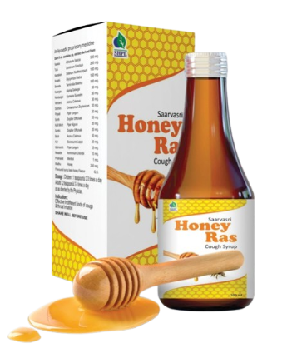
HONEY RAS SYRUP
DESCRIPTION
Saarvasri Herbs Honey Ras is blended with all natural ingredients which are internationally proven to be helpful in different conditions such as Cold, cough, respiratory infections, flu & sore throat etc. It is a good anti allergic, expectorant and relieves congestion.
INGREDIENTS
Vasaka, Tulsi, Kantakari, Mulethi, Baheda, Kulanjan, Kakdasighi, Veknand, Dalchini, Pippali, Sonth, Kali Mirch, Bach, Kur, Pudina, Honey.
BENEFITS
For immediate relief in cough, common cold rhinitis & bronchitis.
It is an expectorant anti-allergic, anti-biotic, anti-septic agent.
Helps in mucolysis & expelling out of cough.
Helps to increase the volume of cough to be expelled out.
DOSAGE
10 to 15ml twice a day or as per advise of health provider.

Slide 11

WITH THE REGULAR USE OF SOME SHPL HEALTH CARE PRODUCTS
TAKE CARE
OF YOURSELF

