Slide 1



Slide 2
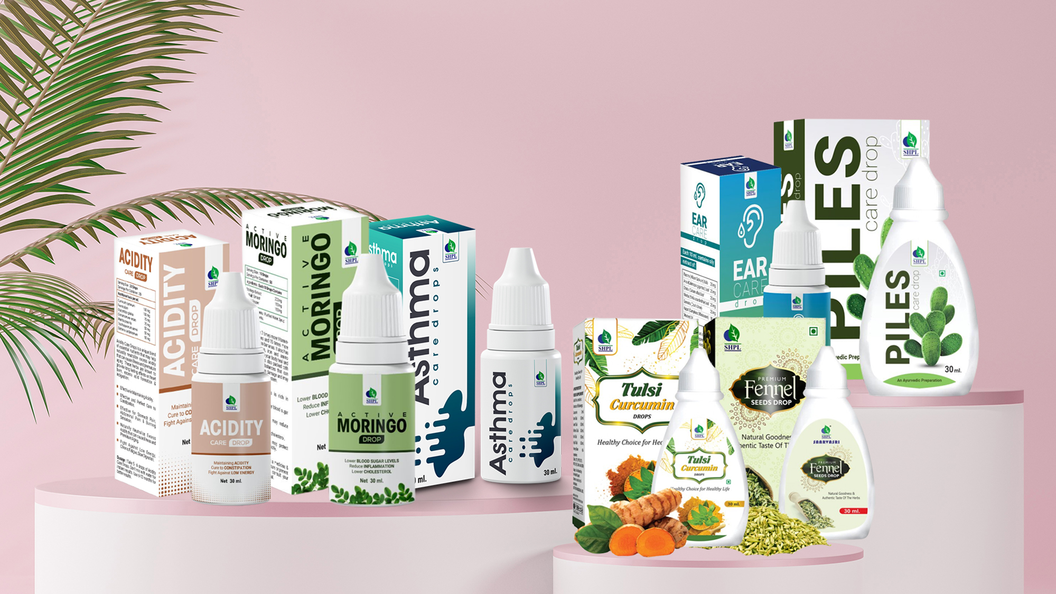
WELLNESS DROPS

Slide 3

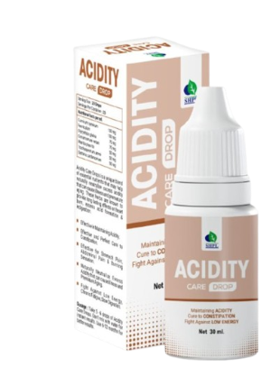
ACIDITY CARE DROPS
DESCRIPTION
Saarvasri Herbs Acidity Care Drops is made of internationally recognized herbs that help naturally neutralize excess acid that can cause illness and premature aging. These herbs are known to provide long lasting effects on heartburn, excess acid formation and indigestion.
INGREDIENTS
Elachi, Saunf, Jeera, Eucalyptus, Ajowain, Pudina, Lavang, Karpur
BENEFITS
Effective in Maintaining Acidity.
Effective and Perfect Cure to Constipation.
Effective for Stomach Pain, Abdominal Pain & Burning Sensation.
Naturally Neutralize Excess Acidity that can cause illness and Premature Aging.
Fight Against Low Energy, Chronic Fatigue, Slow Digestion.
DOSAGE
Take 10 drops with half cup of water twice daily in an empty stomach.

Slide 4
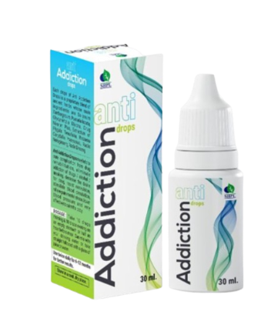
ANTI ADDICTION DROPS
DESCRIPTION
Saarvasri Herbs Anti-Addiction Drop is a combination of unique blend of ancient herbs which are internationally known to quit smoking or in-taking alcohol or drugs and then helps in balancing the emotional, mental and psychological responses of human being and also gradually eliminating the crave for these addictions. Thus, it provides long lasting relief from any kind of harmful addiction. Also it restores the condition of the body and supplies essential vitamins, minerals and nutrients in the body that has been damaged by consumption of various kind of addiction.
INGREDIENTS
Kanteli, Kudzu, Yasthimadhu, Polygala Tenvifolia, Rhizoma Corydalis
BENEFITS
It helps to eliminate the reactions of intaking various types of harmful addictives.
It helps to balance emotional, mental and psychological responses.
It nourishes our body cells.
It decreases the cravings of addictions.
DOSAGE
Take 10 drops with half cup of water/ milk/ dal/ any kind of juice etc. twice daily.

Slide 5
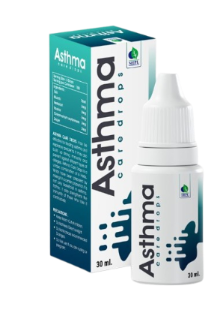
ASTHMA CARE DROPS
DESCRIPTION
Asthma, also called bronchial asthma, is a disease that affects your lungs. It’s a chronic (ongoing) condition, meaning it doesn’t go away and needs ongoing medical management. Saarvasri Herbs Asthma Care is a 100% natural product. Asthma Care has different herbs & other natural ingredients that may give relief to reactions of asthma, wheezing, bronchitis, shortness of breath, coughing & tightness in chest.
INGREDIENTS
Tulsi, mulethi, Kantikari, Vasaka, Cinnamon, Ginger
BENEFITS
It prevents asthma attacks.
It maintains normal lung function.
It strengthens the immune system.
It relaxes the muscles of the breathing passages.
It helps to decrease the frequency of asthma attacks.
It reduces asthmatic symptoms like wheezing, shortness of breath, chest tightness etc.
DOSAGE
Take 10 drops with half cup of water twice daily in an empty stomach.

Slide 6
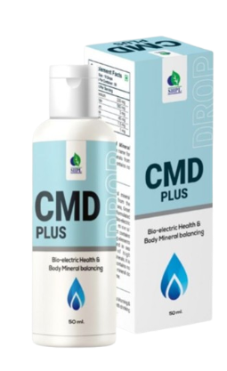
CMD PLUS DROPS
DESCRIPTION
It is 100% natural with no other ingredients added. It contains a full spectrum of all the minerals in a balance natural to the body. It is highly concentrated being 78 times more concentrated than sea water and contains over 84 ionically charged trace minerals. CMD is the perfect solution for replenishing your body with the nutrients you need to maintain optimum health.
INGREDIENTS
Magnesium, Chloride, Sodium, Sulfate, Lithium, Boron
BENEFITS
CMD activates system of the body.
Helps in getting rid of damaged skin or skin that is in bad health.
It's very effective in allergy.
Keeps heart healthy and healthy skin.
It's very effective in diabetic condition.
Helps in hypertension, osteoporosis and stroke.
DOSAGE
Take 10 drops with half cup of water twice daily in an empty stomach.

Slide 7
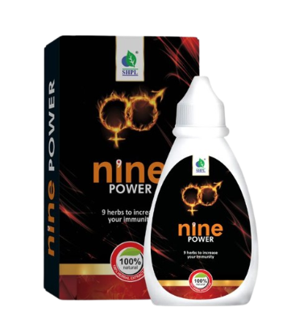
NINE POWER DROPS
DESCRIPTION
Saarvasri Herbs Nine Power Drop is a premium natural formulation for general sexual health enhancement. It improves the blood circulation of the body. It is formulated and designed to enhance sexual performance without unwanted side effects of prescription drugs.
INGREDIENTS
Ashwagandha, Safed Musli, Satavari, Kaunch Beej, Vidarikanda, Jaiphal, Guduchi, Ginseng, Kesar
BENEFITS
It instantly improves sexual energy, fights against sexual debility & sexual weakness.
It improves blood circulation and helps in paralysis.
It restores vitality and increases the stamina.
This product increases natural excitement, response to stimulation and give fantastic staying Energy and stamina for extended sexual performance.
It also significantly increases sex drive!
DOSAGE
Take 4-5 drops with half cup of water twice daily in an empty stomach.

Slide 8
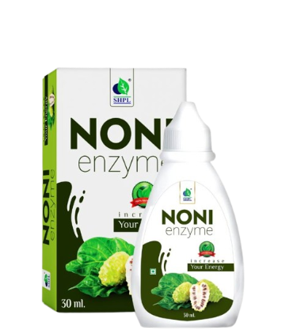
NONI ENZYME DROPS
DESCRIPTION
The noni fruit or Morinda Citrifolia has been used since ancient times for its medicinal properties which boosts the immune system and helps in detoxification. Noni fruit is rich in antioxidants, Vitamin C, Vitamin B3, Vitamin A and Iron. Noni juice is said to be a magical drink as it affects so many bodily systems positively. Saarvasri Noni Enzyme is made of pure Noni Extract. The extract is in a highly concentrated form so that a very small quantity will be sufficient at a time. Noni Enzyme can penetrate the body cells rapidly, help in absorption of nutrients by the cells. It promotes micro-circulation and corrects the metabolism processes in the body, besides strengthening the self-defense ability of the cells.
INGREDIENTS
Pure Noni Extract.
BENEFITS
Fights Inflammation.
Promotes Heart Health.
Improves Brain Health.
Improves Skin Health.
Improves Digestive Health.
Strengthens Hair.
Supports in Cellular Repairing.
Helps Relieve Fatigue.
Improves Liver Health.
Boosts Immunity.
DOSAGE
Take 4-5 drops with half cup of water twice daily in an empty stomach.

Slide 9
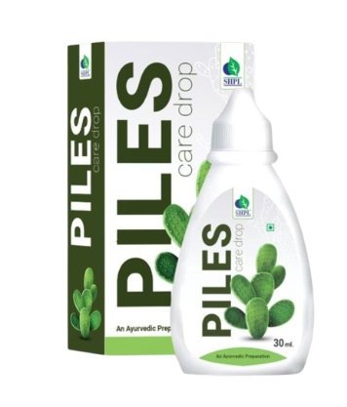
PILES CARE DROPS
DESCRIPTION
Piles is may be caused due to constipation, pregnancy, stomach problems etc. Saarvasri Herbs Piles Care Drop shrunken your piles and relieves discomfort. It soothes your itching and reduces inflammation. Give yourself freedom from the problem of piles by taking this piles care tablets infused with herbal ingredients. We use all natural and herbal ingredients for zero side effects.
INGREDIENTS
Moringa, Ashwagandha, Nux Vomica, Cassia Fistula, Piper Nifurm, Kang Seeds, Pumba Leaf
BENEFITS
Helpful in Chronic constipation, Hemorrhoids, fissure in ano, bleeding and non bleeding piles, fistula, internal and external piles, painful defecation, rectal inflammation, peri-anal abscess, rectal prolapse.
It helps in maintaining the regular routine circulation in the anal area while sitting and also supports the health of the surrounding tissue of the anal opening.
Has anti-inflammatory properties, and is fast in penetrating body tissues.
DOSAGE
Take 10 drops with half cup of lukewarm water twice daily in an empty stomach.

Slide 10
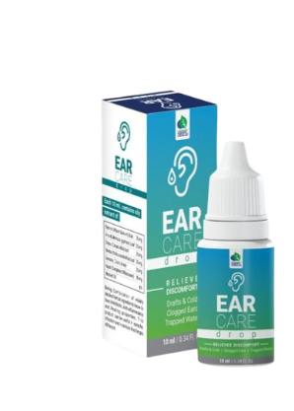
EAR CARE DROPS
DESCRIPTION
Ear infection is an extremely painful infection for us and can cause a lot of discomfort. Ear infection may be fungal or bacterial in nature and can be effectively managed by the use of Saarvasri Herbs Ear Care Drops. The strong antimicrobial properties of the ear drops can bring immediate relief against the symptoms of ear infections - itching and irritation in ears.
INGREDIENTS
Rasona Bulb, Arka Leaf, Dhatur Leaf, Nimba Leaf, Karpur, Musterd Oil
BENEFITS
It is used to relieve pain, congestion, and swelling caused by middle ear Inflammation.
It is also used to help remove earwax.
This product may also contain glycerin which helps to soften the earwax and helps to protect the skin.
DOSAGE
Take 1 drop into each ear twice daily.

Slide 11
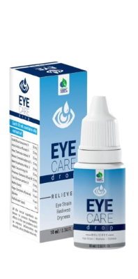
EYE CARE DROPS
DESCRIPTION
Saarvasri Herbs Eye Care Drops is to recover various conditions of the eye. It contains no medication and are meant to lubricate the eyes or to rinse out toxins.
INGREDIENTS
Gulab, Amla, Harar, Bahera, Neem, Haldi, Punarnava, Tulsi, Madhu, Karpur, Glycerine.
BENEFITS
It helps to replace your eye’s natural moisture when your eyes aren’t making enough on their own.
It relieves dryness and irritation, promoting comfort.
In an injured eye, artificial tears also promote surface healing, increase comfort by reducing the feeling of a surface scratch and flush out any residual contaminating or injurious particles.
It prevents further damage by keeping the eye lubricated.
DOSAGE
Take 1 drop into each eye twice daily.

Slide 12
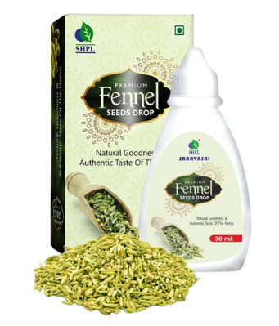
FENNEL SEED DROPS
DESCRIPTION
Saarvasri Fennel Seed Drop is such a wonderful product that may provide you the ultimate wellness. Foeniculum vulgare, commonly known as fennel, is a flavorful culinary herb and medicinal plant. Aside from its many culinary uses, fennel and its seeds offer a wide array of health benefits and may provide antioxidant, anti-inflammatory, and antibacterial effects. Fennel seeds are low in calories but provide many important nutrients. It is a good source of vitamin C, a water-soluble vitamin for immune health, tissue repair, and collagen synthesis.
INGREDIENTS
Fennel Seeds Extract.
BENEFITS
Improves skin appearance
Purifies blood
Helps to improve eyesight
Promotes weight loss
Reduces Gas and Acidity
Combats bad breath
Improves digestive health
Helps to regulate blood pressure
Reduces asthma and other respiratory ailments
Promotes lactation
DOSAGE
4-5 drops mixed with half cup of water daily two times or as directed by experts.

Slide 13
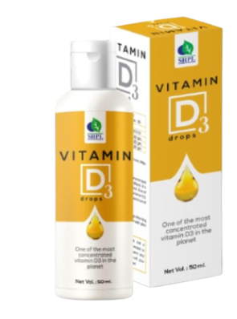
VITAMIN D3 DROPS
DESCRIPTION
Saarvasri Herbs Vitamin D3 Drops is enriched with Sea Weeds and Mushrooms that can help your body to detoxify and protect your body from pollution naturally. It can boost our immunity power.
INGREDIENTS
Ganoderma Lucidium, Cordyceps Sinensis, Kelp Extract
BENEFITS
Boost the Production of Vitamin D
Enhance Immune System Function
Lower Cholesterol Levels
Helps Prevent Prostate Cancer and Breast Cancer
Boost Strength of Bone
Fight against Free Radicals
Detoxifies Your Body
DOSAGE
Take 10 drops with half cup of water twice daily in an empty stomach or as directed by experts.

Slide 14
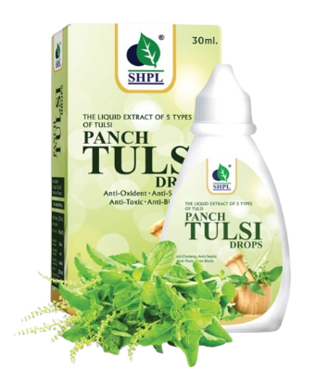
PANCH TULSI DROPS
DESCRIPTION
It is well known in the epics that Tulsi is known for its medicinal values. Apart from rituals and religion, Tulsi itself holds the position to be the Worlds best medicinal plant which has properties like anti – oxidant, anti – aging, anti – viral, anti – bacterial, anti – flu, etc . Saarvasri Herbs Panch Tulsi Drop has a lot of benefits.
INGREDIENTS
Ram Tulsi, Shwet Tulsi, Krishna Tulsi, Van Tulsi, Arjak Tulsi,
BENEFITS
Gives immune support, helps wound healing
Antimicrobial protection for your body
Eases respiratory illness
Helps the body combat physical and mental stress
Good for digestive health
Keeps away the deadly fevers away like dengue, malaria, swine flu, etc.
It helps in getting from the problem of sore throat, running nose, cold, etc.
Effective in cough, cold, acidity, constipation, stomach ache and abdominal pain.
DOSAGE
Take 3-4 drops with half cup of water twice daily in an empty stomach or as directed by experts.

Slide 15
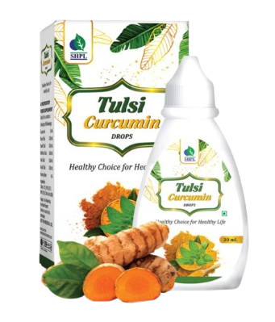
TULSI CURCUMIN DROPS
DESCRIPTION
Saarvasri Herbs Tulsi Curcumin Drop is an anti-bacterial, Anti-viral and anti-fungal product to boost our immunity power. It is a perfect blend of nature’s two wonderful herbs Curcumin and Tulsi for protecting us from environmental hazards and toxinated pollutants to keep us healthy. By using this product we can lead a quality healthy life.
INGREDIENTS
Ram Tulsi, Shwet Tulsi, Krishna Tulsi, Van Tulsi, Arjak Tulsi, Curcumin
BENEFITS
Helps suppress cough and aids the mobilization of mucus. Assists in calming and dilating the lung's airways, thus relieving chest congestion.
It is very effective for any kind of skin infections and skin related disorders.
Very helpful for allergies.
It is an anti-bacterial, anti-viral and anti-fungal product to control disease.
It boosts our immunity power.
It is able to tackle stress, anxiety, and inflammation
DOSAGE
Take 3-4 drops with half cup of water twice daily in an empty stomach or as directed by experts.

Slide 16
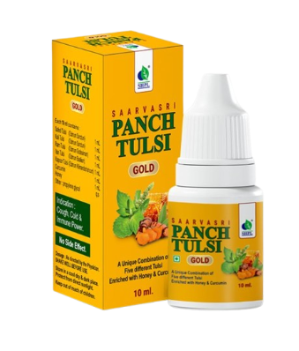
PANCH TULSI GOLD DROPS
DESCRIPTION
It is well known in the epics that Tulsi is known for its medicinal values which has properties like anti – oxidant, anti – aging, anti – viral, anti – bacterial, anti – flu, etc . Saarvasri Herbs Panch Tulsi Gold Drops has a lot of benefits. It has super natural health curing qualities and helpful in all types of Allergies. It has beneficial effect on mind and body. It gives relaxation to mind and body. Scientists have also acknowledged the medicinal properties of Tulsi.
INGREDIENTS
Ram Tulsi, Shwet Tulsi, Krishna Tulsi, Van Tulsi, Kapoor Tulsi, Honey, Curcumin
BENEFITS
Effective in cough, cold, acidity, constipation, stomach ache and abdominal pain.
Keeps away the deadly fevers away like dengue, malaria, swine flu, etc.
It has anti-bacterial and anti-viral action.
It helps in getting from the problem of sore throat, running nose, cold, etc.
Its acts as immunity booster.
Useful for adjuvant in respiratory condition, adjuvant in digestion, adjuvant in skin conditions.
A drop of Tulsi will be very much effective in sinusitis and the issues related to nose
DOSAGE
Take 3-4 drops with half cup of water twice daily in an empty stomach or as directed by experts.

Slide 17

WITH THE REGULAR USE OF SOME SHPL HEALTH CARE PRODUCTS
TAKE CARE
OF YOURSELF

